Slide 1
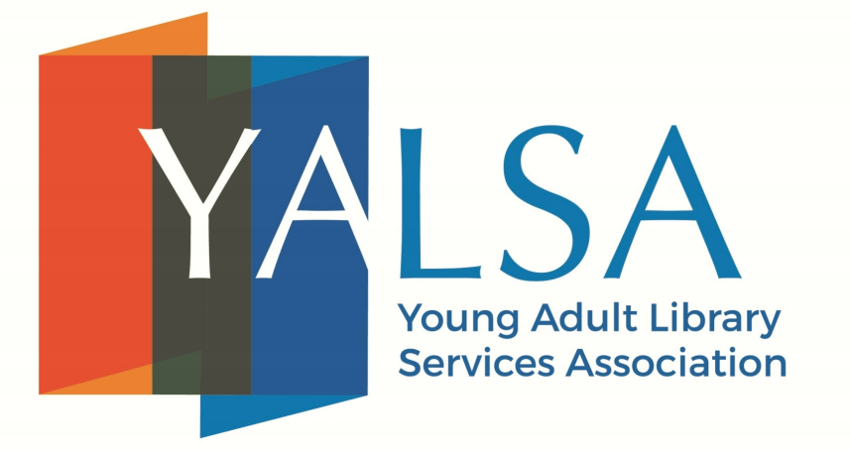
Safe Spaces for Aros and Aces
Presented by Sam Helmick, Elizabeth Graham, Kadie Craighead,
and The Ace and Aro Advocacy Project
Notes:
ID: YALSA logo - Young Adult Library Services Association
Safe Spaces for Aros and Aces
Presented by Sam Helmick, Elizabeth Graham, Kadie Craighead, and The Ace and Aro Advocacy Project
Speaker Notes: Content warnings: This presentation mentions sensitive topics such as discussions of sexual violence, racism, and other forms of bigotry and violence, particularly on the slides discussing the harms created by compulsory sexuality and amatonormativity and the intersection with other forms of marginalisation

Slide 2
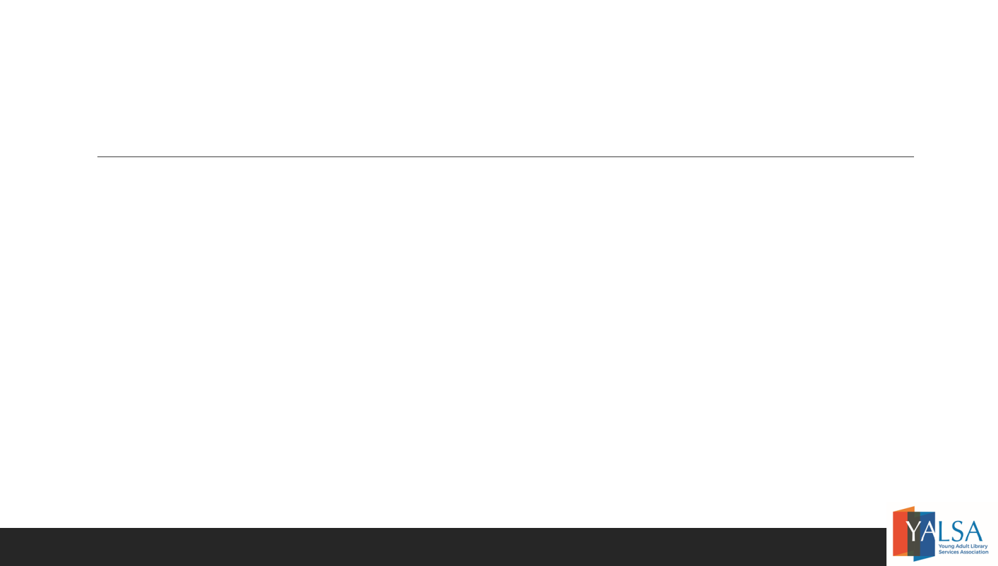
Introductions
Sam Helmick, they/them, Iowa City Public Library
Elizabeth Graham, she/her, New York Public Library and Aces NYC
Kadie Craighead, she/they, The Ace and Aro Advocacy Project
Notes:
ID: Introductions
Sam Helmick, they/them, Iowa City Public Library
Elizabeth Graham, she/her, New York Public Library and Aces NYC
Kadie Craighead, she/they, The Ace and Aro Advocacy Project
An image of the TAAAP logo
Speaker notes: One presenter’s name and information was removed for privacy.

Slide 3
Definitions: What is Asexuality?
Asexual: A sexual orientation referring to people who experience little to no sexual attraction and/or desire to form sexual relationships. Asexual people can be nicknamed “aces” for short.
Key concept to understanding asexuality is attraction; aces do not experience sexual attraction to other people. Asexuality is not a choice; it is inherent.
Does not mean aces:
Dislike sex
Choose to not have sex (celibacy)
Think sex is a sin
Asexual people may or may not experience romantic attraction and can have any romantic orientation.
Notes:
ID: Definitions: What is Asexuality?
Asexual: A sexual orientation referring to people who experience little to no sexual attraction and/or desire to form sexual relationships. Asexual people can be nicknamed “aces” for short.
Key concept to understanding asexuality is attraction; aces do not experience sexual attraction to other people. Asexuality is not a choice; it is inherent.
Does not mean aces:
-Dislike sex
-Choose to not have sex (celibacy)
-Think sex is a sin
Asexual people may or may not experience romantic attraction and can have any romantic orientation.
Speaker notes: The common definition focuses around attraction rather than someone's behaviour or action, though some people identify as ace due to not desiring sex, for example. Some aces have libidos or sex drives and some don't, and either experience is normal.

Slide 4
Definitions: What is Aromanticism?
Aromantic: A romantic orientation referring to people who experience little to no romantic attraction and/or desire to form romantic relationships. Aromantic people are often called “aros” for short. Just like any other orientation, you cannot choose to be aromantic.
Does not mean aros:
Are incapable of any kind of love or affection
Hate other people
Are “sociopaths”
Aromantic people may or may not experience sexual attraction and can have any sexual orientation. They also might use only their aromantic identity to describe themselves and not identify with any sexual orientation.
Notes:
ID: Definitions: What is Aromanticism?
Aromantic: A romantic orientation referring to people who experience little to no romantic attraction and/or desire to form romantic relationships. Aromantic people are often called “aros” for short. Just like any other orientation, you cannot choose to be aromantic.
Does not mean aros:
- Are incapable of any kind of love or affection
- Hate other people
- Are “sociopaths”
Aromantic people may or may not experience sexual attraction and can have any sexual orientation. They also might use only their aromantic identity to describe themselves and not identify with any sexual orientation.
Speaker notes: The definitions that emerged as most common in the ace and aro communities center around lack of attraction, but this doesn’t necessarily cover everyone who identifies as ace and/or aro. Some people come to identify with aromanticism due not desiring romance, and some people come to identify with asexuality due not desiring sex, and these experiences are valid and have been seen since the early days of the online aspec community.
Orientation terms are meant to help people describe themselves and their experiences, not to put them in rigid boxes. What matters is what a person feels is and isn’t important to their identity. For example, if someone occasionally experiences attraction but has no desire to act on it and does not consider it to be important or relevant to their identity or life, they might identify with an aspec orientation on that basis.
Other times, it can be difficult to identify when something isn’t there - attraction can be a nebulous concept, and the lack of it even more so. Sometimes, not engaging in romance might have a bigger, more tangible or visible impact on an aro person’s life than their lack of romantic attraction. Similarly, an ace person might feel that not engaging in sex has a bigger, more tangible or visible impact on their life than their lack of sexual attraction.
Being aromantic doesn’t necessarily dictate one’s attitudes toward romance or other relationships. Some aros do enter romantic relationships. Some aros form nonromantic committed relationships, such as queerplatonic relationships. Some aros are nonpartnering. Aros can be romance favorable, romance neutral, romance averse, or romance repulsed, and aces can be sex favorable, sex neutral, sex averse, or sex repulsed, and those feelings might vary depending on the situation.
While orientation is not a choice, it can be fluid for some people, and that doesn’t make it any less natural.

Slide 5
Asexual and Aromantic Spectra
Asexual
Not/minimally experiencing sexual attraction
or desiring sexual relationships
Greysexual
Experiencing sexual attraction rarely, weakly, under limited circumstances, or in another way that differs from allos
Demisexual
Not experiencing sexual attraction unless a strong emotional bond has been formed first
Sexual Orientation
Aromantic
Not/minimally experiencing romantic attraction or desiring romantic relationships
Greyromantic
Experience romantic attraction rarely, weakly, under limited circumstances, or in another way that differs from alloros
Demiromantic
Not experiencing romantic attraction unless a strong emotional bond has been formed first
Romantic Orientation
Notes:
ID: Asexual and Aromantic Spectra
Sexual orientation:
Asexual
(the asexual flag)
Not/minimally experiencing sexual attraction or desiring sexual relationships
Greysexual
(the greysexual flag)
Experiencing sexual attraction rarely, weakly, under limited circumstances, or in another way that differs from allos
Demisexual
(the demisexual flag)
Not experiencing sexual attraction unless a strong emotional bond has been formed first
Romantic orientation:
Aromantic
(the aromantic flag)
Not/minimally experiencing romantic attraction or desiring romantic relationships
Greyromantic
(the greyromantic flag)
Experiencing romantic attraction rarely, weakly, under limited circumstances, or in another way that differs from allos
Demiromantic
(the demiromantic flag)
Not experiencing romantic attraction unless a strong emotional bond has been formed first
Speaker notes: Aromanticism and asexuality are spectra representing a diversity of experiences and identities. There are some people who may not fit the strictest definition of the words asexual or aromantic but feel their experience aligns more with asexuality or aromanticism than with other orientations. Several terms, sometimes called microlabels, emerged to describe these types of experiences.
Grey- (sexual/romantic) describes people who experience attraction only rarely, weakly, under limited circumstances, or in another way that significantly differs from allo(ro)s. This is sometimes used as an umbrella term for people who are aspec but not "flat out" aromantic or asexual at the end of the spectrum - in other words, they fall into the grey area between either end of the spectrum - and it is also a complete identity in itself.
Allo stands for allosexual, a term for people who have a sexual orientation that is not asexual, such as bisexual
Alloro stands for alloromantic, a term for people who have a romantic orientation that is not aromantic, such as panromantic
Demi- (sexual/romantic) describes people who do not experience attraction unless a strong emotional bond has been formed first. The emotional connection is a necessary but not sufficient factor.
Quoi- (sexual/romantic) describes people who cannot distinguish clearly between romantic or sexual attraction and platonic attraction or bonds. They may mistake one for the other or not differentiate them at all.
Lith- (sexual/romantic) describes people who may experience attraction and may like the idea of being in a relationship in theory, but they stop experiencing the attraction if it is reciprocated or if they enter an actual relationship, and they may be uncomfortable with the thought of that happening.
Aego- and autochoris- (sexual/romantic) are two prefixes both used to describe people who may have fantasies and enjoy the idea of sexual or romantic activities, but they do not wish to be a participant themselves. This is often described as feeling a disconnect between oneself and the concept of attraction or relationships, and they may only enjoy the hypothetical concept when it's a situation they couldn't possibly be in (for example, they may enjoy porn or romance novels, but possess no desire to participate in the activities depicted).
Fray- (sexual/romantic) describes people who only experience attraction to people they are less familiar with. They may lose the attraction entirely upon getting to know the other person. This is sometimes thought of as the opposite of demi.
Recipro- (sexual/romantic) describes people who only experience attraction after they know someone is attracted to them. Because the attraction is reciprocal, they might worry that their feelings are in some way "less than" those of the person who originated interest.
(Ace/Aro) -flux describes people who fluctuate along the spectrum, between asexual and allosexual or aromantic and alloromantic. Some people who are aceflux or aroflux will always stay within the asexual or aromantic spectrum, while others may occasionally fall outside of it.
In part due to the lack of recognition and awareness around aromanticism and asexuality, and the stifling expectations of compulsory sexuality and amatonormativity, many more terms have been coined by people seeking a way to describe their specific experiences.
It's important not to conflate aspec identities with neurodivergence or with trauma or to assume that one is the result of the other. They are not the same. An aspec identity doesn't indicate neurodivergence or trauma, and vice versa. However, these things are not mutually exclusive and can influence each other. For example, nebula- (sexual/romantic) is similar to quoi- (sexual/romantic) but specifically for neurodivergent people who cannot clearly distinguish (sexual/romantic) attraction from platonic attraction or bonds because of their neurodivergence.
Furthermore, some people do identify as aspec because of trauma. Caed- (sexual/romantic) is specifically for people who have experienced trauma and feel as though their ability to experience attraction has been "cut away" from them due to their trauma. If someone identifies this way, it is still never appropriate to treat anyone's orientation as something to be "fixed." Do not equate recovery with becoming comfortable with sex or romance, and do not assume that is a desired or healthy recovery goal for someone to work toward, either. Sex and romance are not essential to life and it is okay for someone to never want or engage in those things. Being healthy does not mean "being allosexual and alloromantic."
People come to aspec identities in many ways, and the way they understand themselves and their experiences is valid no matter what their reasons (or lack thereof). They deserve to be supported in their journeys of identity development, not doubted or invalidated.

Slide 6
Compulsory Sexuality and Amatonormativity
Compulsory Sexuality and Amatonormativity
Compulsory Sexuality: “... scholars have begun to use the term compulsory sexuality to describe the assumption that all people are sexual and to describe the social norms and practices that both marginalize various forms of nonsexuality and compel people to experience themselves as desiring subjects, take up sexual identities, and engage in sexual activity.” Kristina Gupta, “Compulsory Sexuality: Evaluating an Emerging Concept”
Amatonormativity: “... the assumptions that a central, exclusive, amorous relationship is normal for humans, in that it is a universally shared goal, and that such a relationship is normative, in that it should be aimed at in preference to other relationship types. … Amatonormativity prompts the sacrifice of other relationships to romantic love and marriage and relegates friendship and solitudinousness to cultural invisibility.” Elizabeth Brake, Minimizing Marriage
Notes:
ID: Compulsory Sexuality and Amatonormativity
Compulsory Sexuality: “... scholars have begun to use the term compulsory sexuality to describe the assumption that all people are sexual and to describe the social norms and practices that both marginalize various forms of nonsexuality and compel people to experience themselves as desiring subjects, take up sexual identities, and engage in sexual activity.” Kristina Gupta, “Compulsory Sexuality: Evaluating an Emerging Concept”
Amatonormativity: “... the assumptions that a central, exclusive, amorous relationship is normal for humans, in that it is a universally shared goal, and that such a relationship is normative, in that it should be aimed at in preference to other relationship types. … Amatonormativity prompts the sacrifice of other relationships to romantic love and marriage and relegates friendship and solitudinousness to cultural invisibility.” Elizabeth Brake, Minimizing Marriage
Speaker notes: In our society, romance and sex are both seen as key life milestones, essential to human experience, and biological inevitabilities. These attitudes are described by compulsory sexuality and amatonormativity, and they contribute to stigma against aspec people and invalidation of aspec identities. They also directly support rape culture and undermine principles of consent.
Compulsory sexuality is the sociocultural assumption that everyone has or will eventually have sex and is interested in sex. This involves stigma and stereotypes against people who don’t have or haven’t had sex, such as that they are frigid or immature. It intertwines with amatonormativity in that people are expected to form romantic-sexual coupled relationships, and sex is often held up as a special expression of romantic love, so people who do not want to have sex are often told that they cannot be a good romantic partner. People are also assumed to be open to potentially being a sexual partner, and if they are not in a relationship, they are more likely to experience sexual harassment.
The term amatonormativity was coined by Elizabeth Brake and refers to the disproportionate focus on romantic relationships above all else and the widespread assumption that finding romantic love is a universally shared goal. It describes the systemic way in which these sociocultural ideas and norms are upheld - this includes the formal institution of marriage and the thousands of legal benefits it confers. Amatonormativity dictates that couplehood, and marriage in particular, is a special site of morality and a sign of maturity. People who do not want to engage in romance are subject to stigma and stereotypes against them, such as that they are heartless or inhuman, as well as vilification for any sex they may have.

Slide 7
Intersection with Other Forms of Marginalisation
People with other marginalised identities are denied agency over their orientations and their romantic and/or sexual behaviour
Many ethnicities are hypersexualised or desexualised, and those stereotypes can make it difficult to identify with or claim an aspec identity
Stigma, stereotypes, and desirability politics around body types, gender, disability, and neurodivergence can also impact one’s comfort with an aspec identity
Things like lack of interest in sex, romance, and/or committed monogamous relationships are pathologised and listed as disorder criteria
Notes:
ID: Intersection with Other Forms of Marginalization
People with other marginalized identities are denied agency over their orientations and their romantic and/or sexual behavior
Many ethnicities are hypersexualized or desexualized, and those stereotypes can make it difficult to identify with or claim an aspec identity
Stigma, stereotypes, and desirability politics around body types, gender, disability, and neurodivergence can also impact one’s comfort with an aspec identity
Things like lack of interest in sex, romance, and/or committed monogamous relationships are pathologized and listed as disorder criteria
Speaker notes: Stereotypes of other marginalised identities often deny people’s agency over their orientations and their romantic and/or sexual behaviour.
People who are hypersexualised are sexually objectified and assumed to be “overly” sexual, to have sexual desire that is “too much”; to be always sexually interested and available, never saying no; and to be predatory and sexually aggressive.
People who are desexualised are denied the possibility of sexuality and sexual agency; they are viewed as undesirable and often assumed to be incapable of understanding and/or desiring sex. They are often deromanticised as well based on the assumptions of being undesirable and underdeveloped.
Some examples:
Asian men in western culture are desexualised and deromanticised, which has roots in immigration restrictions against Asians that wouldn’t allow Asian men to settle or marry because they were viewed as a threat to white supremacy and the “purity” of white women.
Other men of colour, particularly black men and Native men, are hypersexualised and stereotyped as sexually aggressive, predatory, and uncivilised. These stereotypes can be traced back to white settlers, again viewing men of other races and ethnicities as a threat to white supremacy and the “purity” of white women.
Asian women are fetishised by racial stereotypes, sexualised yet assumed not to have sexual desires or agency of their own, instead being ultra-submissive to the sexual desires of men. This has roots in the sexual violence perpetrated during military occupation of eastern Asian countries in WWII, as well as marriage trafficking that continues today.
Native and First Nations women are also fetishised as an “exotic” race and hypersexualised yet denied sexual or romantic agency, stemming from colonialism, and they face especially high rates of sexual violence.
Many Latine and Hispanic peoples are hypersexualised and romanticised by being stereotyped as “spicy,” “fiery,” passionate lovers, in both a romantic and sexual way, assumed to naturally have excessive desires.
Black women are denied sexual and romantic agency; they are sometimes desexualised and deromanticised, assumed to have no desire, through the mammy stereotype and sometimes hypersexualised, assumed to have everpresent sexual desire, through the Jezebel stereotype, and both of these stereotypes have roots in the dehumanisation imposed by slavery.
This often intersects with body type. For example, curvy femmes are assumed to be inherently sexual because their bodies are hypersexualised.
Fat people and disabled people are desexualised, deromanticised, and viewed as undesirable, and body positivity movements often push for acceptance by asserting and emphasising romantic and sexual desirability, which can be inaccessible and unhelpful to aspecs.
Disinterest in sex, romance, and/or committed monogamous relationships are pathologised and viewed as medical and mental health issues, often preventing aspecs from receiving the care they seek. Health professionals may attibute their aspec identity to a health problem or to their neurodivergence or disability, or vice versa. To them, health and recovery become synonymous with seeming alloromantic and allosexual.
In some religions and in cultures with traditions of arranged marriage, people may be raised to believe that sex is not a function of desire but rather a marital requirement to have children, and likewise that marriage is an imperative of the family and one’s own desires are secondary or even irrelevant.
Expectations and stereotypes of binary gender roles also intersect, and we’ll cover that more in the next few slides.
Clashing stereotypes get assumed to override or nullify an aspec identity, which can make someone feel like an aspec identity is impossible for them to have or like they are “less” of their other identity. Coinciding stereotypes get used to invalidate an aspec identity as if it is their natural default, which can make someone feel like they are confirming stereotypes of their other identity or not “really” aspec. Either way, it’s often more difficult to assert an aspec identity, be secure in and feel no dissonance between one’s identities, and be believed.

Slide 8
How Compulsory Sexuality Creates Harm
Has a compounding effect on hypersexualisation
Upholds pressures to have sex, whether that pressure is internally felt or being applied toward others, potentially coercively
Sex is often seen as a biological and/or familial responsibility - as part of couplehood, “having a family,” and continuing family lines - such that a lack of interest may be viewed as something to be dismissed
Lack of sex and/or sexual interest is viewed as both a physical and mental health issue
Notes:
ID: How Compulsory Sexuality Creates Harm
Has a compounding effect on hypersexualisation
Upholds pressures to have sex, whether that pressure is internally felt or being applied toward others, potentially coercively
Sex is often seen as a biological and/or familial responsibility - as part of couplehood, “having a family,” and continuing family lines - such that a lack of interest may be viewed as something to be dismissed
Lack of sex and/or sexual interest is viewed as both a physical and mental health issue
Speaker notes: Both compulsory sexuality and amatonormativity create a lot of harmful norms that we grow up with. While they’re always harmful to everyone, they can be especially harmful and noticeable to aspec youth when they and their peers may start to explore, or be expected to explore, romance, sexuality, dating, and so on, which may also be around the time they might start reflecting more on their orientation and their self identity. These experiences can shine a harsher light on the intersections of marginalisation they face.
Expectations of sexuality differ significantly by gender expectations and stereotypes as well, and they are both heteronormative and cisnormative. For example:
Men’s sexuality is assumed to be aggressive and not romantic, and toxic masculinity discourages emotional openness. However, if they do not engage in romance, they are often stereotyped as predatory and exploitative.
Women’s sexuality is assumed to only exist as a function of romance. They are stereotyped as romantic and expected to be sexually available, but they are not expected to have their own primary sexual desire. Their sexual desire is expected to be responsive, such that they are willing to fill a romantic partner’s sexual needs.
These stereotypes and racial stereotypes are frequently enshrined in medical and psychological doctrine. For example, the DSM-5 pathologises a lack of sexual desire and separates the diagnoses for men and women based on the assumption that men report, and this is a direct quote, “significantly higher intensity and frequency of sexual desire compared with women.” It also asserts that East Asian people have less sexual desire than people in western cultures.
Men’s sexual desire is considered disordered if they do not desire sex, but women aren’t assumed to desire sex naturally. Instead, their sexual desire is considered disordered if they don’t get aroused during sex, are not interested in initiating sex with their partner - assumed to be within the context of a committed relationships - and are not receptive to their partner’s initiation of sex.
While this edition of the DSM finally carved out an exception for asexuality, it still reinforces compulsory sexuality and gendered stereotypes. The entire sexual dysfunction section also generally assumes the context of a committed romantic relationship, with some criteria only being evaluated in relation to the socionormative expectations of a romantic-sexual relationship, such that sex therapy is conflated with couple’s therapy. These kinds of expectations are invalidating toward all kinds of aspec people and can exclude them from getting care.
Trans and nonbinary people may face different stereotypes of their perceived gender as well as their actual gender identity. Being trans or nonbinary is often wrongly viewed as a sexual fetish in itself, and trans people in particular are often stereotyped as predatory.
All of these expectations of when and how to engage in sex intersect with stereotypes of other identities and can complicate one’s identification and/or compound negative stereotypes.

Slide 9
How Amatonormativity Creates Harm
Devalues nonromantic interpersonal relationships and erodes community
Teaches us that we’re not complete on our own, can’t have fulfilling lives without being part of a romantic couple unit, and are better off in an unsatisfactory or even unhealthy relationship than single
Engineers artificial scarcity around romance, sex, physical affection, emotional intimacy, support structures, and other forms of care
Directly supports sex-negative attitudes and gender role stereotyping
Western cultural hegemony that falsely universalises patriarchal and white supremacist ideals
Notes:
ID: How Amatonormativity Creates Harm
Devalues nonromantic interpersonal relationships and erodes community
Teaches us that we’re not complete on our own, can’t have fulfilling lives without being part of a romantic couple unit, and are better off in an unsatisfactory or even unhealthy relationship than single
Engineers artificial scarcity around romance, sex, physical affection, emotional intimacy, support structures, and other forms of care
Directly supports sex-negative attitudes and gender role stereotyping
Western cultural hegemony that falsely universalizes patriarchal and white supremacist ideals
Speaker notes: In our society, romance is treated as intrinsically better and more valuable than other forms of interpersonal bonds. People commonly assume that committed monogamous romantic relationships are a universal and natural norm and goal, but the norm of monogamy was created and imposed by patriarchal societies to control women’s sexuality in order to ensure paternity of landowning men for the purpose of patrilineal property inheritance. Before and outside of such societies, neither sexual exclusivity nor long-term/indefinite commitment were normative expectations of romantic relationships, and child raising responsibilities were typically shared across the community or extended kin instead of an insular nuclear family unit. Marriage has also been selectively promoted or prohibited for certain groups throughout history as a form of social control for enforcing white supremacy - for example, through colonialism and cultural genocide of Native Americans, slavery and Jim Crow, immigration restrictions against Asians, and marriage fundamentalist welfare legislation.
Though marriage has been reframed as individual fulfillment and companionate romantic love in order for the imposed norms to withstand women gaining legal personhood and rights, the legalization of no-fault divorce, free love, and other civil rights movements, it is still property law and the societal norm of monogamy continues to exist to enable families to hoard their wealth and to assign parents control over their children. Amatonormativity is, of course, especially damaging to aromantic people, particularly aromantic allosexuals, but it is a fundamental axis of oppression in a system that benefits only the privileged.
Amatonormativity harms everyone very directly, such as by promoting isolation and unhealthy relationship views. The belief that committed romantic relationships have special value leads to the overlooking of other important interpersonal relationships and the erosion of community. For example, sociological research consistently shows that people become more insular when they get married, regardless of whether or not they have children. They become less likely to spend time with or help their friends, parents, siblings, neighbors, or community organizations, and they have less friends than people who stay single. This is why many aros fear losing their social groups and support networks when their alloromantic friends enter romantic relationships.
Amatonormativity is also intrinsically linked with sex shaming because it pushes monogamous romantic commitment. When we’re expected to get all our social needs met by an exclusive romantic relationship, it creates a scarcity mindset around physical affection, emotional intimacy, support structures, and sex. For example, the popular idea of people having “the one” they’re “meant to be” with, or a “soulmate,” discounts the effort that one must choose to put into a relationship to make it work, and it displaces personal accountability. When a relationship doesn’t work out, people may write it off as not being “real” because it wasn’t “the one” they were “meant to be” with, or they may stay in a bad relationship because they think they can only find love once and it’s so all-important that preserving the relationship is worth any sacrifice.
That artificial scarcity is then accompanied by inherent sex shaming, gender role stereotyping, and the idea that romance and sex are some kind of zero-sum game and power struggle, all attitudes which support rape culture. People are wrongfully taught that all women want is romance and all men want is sex, so they have to exploit each other in order to get what they want. These toxic norms encourage emotional manipulation and discourage open communication.
Moreover, sex without romance is condemned as immoral and harmful while romantic sex is pedestalized as a special expression of love. This dehumanizes aro and ace people. Humanity isn’t conditioned on love of any kind, and love doesn’t have moral significance. When love is considered so unassailably sacrosanct and pure, it gets used to excuse or mitigate things that should be inexcusable: domestic abuse; child abuse; spousal and intimate partner violence, including sexual violence; so-called “crimes of passion”; marriage trafficking; romantic harassment; stalking; and so on. In fact, the majority of violence against women is committed by their current or ex husbands or romantic partners, and most murders of women are committed by intimate partners or family members. Love shouldn’t be painted as the ultimate universal good, and the word “romantic” isn’t synonymous with “virtuous and wholesome.”
Just like compulsory sexuality encourages sexual harassment, amatonormativity and the accompanying gender role expectations encourage romantic harassment. Our society teaches women that they should “play hard to get” and that being “too easy” is a bad thing, and men are taught that persistent pursuit of a romantic interest is not only acceptable but expected in order to “win” someone over. In fact, society doesn’t really have concepts of romantic harassment or romantic objectification. If someone refuses to “give up” on making romantic advances after being rejected, this persistence is commonly considered desirable behavior instead of unacceptable behavior, but this is just as inappropriate as repeated unwanted sexual advances. It’s harassment and it’s a violation of boundaries. Unfortunately, the recipients of this reprehensible behavior are often vilified if they don’t “give the person a chance.” Treating love, including and especially romantic love, as inherently moral and pure fails to recognize these types of harms. No one is ever entitled to a relationship or to having their romantic feelings reciprocated, just like no one is ever entitled to sex. It is not a prize people can earn by being friendly. Consent requires the freedom to say “no” without fear of repercussion.

Slide 10
The Relationship Escalator
Coined by Amy Gahran
Progressive hierarchy of relationships
Each step is presumed to inevitably follow the “lower” rung
Sets a standard by which the importance and seriousness of relationships is judged
Assumes lifelong exclusive commitment and the formation of a nuclear family unit to be the ultimate goal, always
children
marriage
cohabitation
a committed, monogamous relationship
emotional investment, “catching feelings”
dating and/or having sex
Notes:
ID: The Relationship Escalator
(An image of an arrow pointing up with the phrases from bottom to top: “dating and/or having sex”, “emotional investment, ‘catching feelings’”, “a committed, monogamous relationship”, “cohabitation”, “marriage”, “children”)
Coined by Amy Gahran
Progressive hierarchy of relationships
Each step is presumed to inevitably follow the “lower” rung
Sets a standard by which the importance and seriousness of relationships is judged
Assumes lifelong exclusive commitment and the formation of a nuclear family unit to be the ultimate goal, always
Speaker notes: Furthermore, consenting to sex is not consenting to romance, and vice versa. Many people think that romantic attachment is an inevitability of having sex, but that is an amatonormative misconception. Aroallos often have trouble finding sexual partners who respect their boundaries surrounding romance, just like how it’s often difficult for alloro aces to form romantic relationships where their sexual boundaries are respected.

Slide 11
Examples of Amatonormative Tropes in Media
A character supposedly transforms into a good/better person because they develop romantic feelings; romantic love is seen as redeeming
Characters who do not desire romantic relationships undergo “character development” by “meeting the right person” and ending up in a relationship
All single characters get paired off into couple units
Happy endings are equated with romantic endings; love saves the day and solves all problems
Casual sex “inevitably” leads to romantic feelings and a relationship
Romantic angst and drama without reason or build-up is somehow universally understood and a compelling emotional narrative
Notes:
ID: Examples of Amatonormative Tropes in Media
A character supposedly transforms into a good/better person because they develop romantic feelings; romantic love is seen as redeeming
Characters who do not desire romantic relationships undergo “character development” by “meeting the right person” and ending up in a relationship
All single characters get paired off into couple units
Happy endings are equated with romantic endings; love saves the day and solves all problems
Casual sex “inevitably” leads to romantic feelings and a relationship
Romantic angst and drama without reason or build-up is somehow universally understood and a compelling emotional narrative
Speaker notes: The messaging is that people have to be coupled in order to be happy, that we are not whole or fulfilled on our own, that romantic harassment is acceptable and wholesome

Slide 12
Why Does This Matter?
You are already serving asexual and aromantic youth in your libraries whether you know it or not!
The Trevor Project’s October 2020 poll found in their sample of over 40,000 LGBTQ youth, 10% identified as asexual or ace spectrum.
Asexual youth reported higher rates of depression and anxiety compared to the overall LGBTQ sample.
Little research data exists on aromantic people due to underrecognition and underinclusion.
Asexual and aromantic youth have little cultural awareness and representation in popular culture, and face stigma for their orientations. As a section of the population routinely erased and made invisible, their specific needs must be addressed. #LibrariesAreForAll
Notes:
ID: Why Does This Matter?
You are already serving asexual and aromantic youth in your libraries whether you know it or not!
The Trevor Project’s October 2020 poll found in their sample of over 40,000 LGBTQ youth, 10% identified as asexual or ace spectrum.
Asexual youth reported higher rates of depression and anxiety compared to the overall LGBTQ sample.
Little research data exists on aromantic people due to underrecognition and underinclusion.
Asexual and aromantic youth have little cultural awareness and representation in popular culture, and face stigma for their orientations. As a section of the population routinely erased and made invisible, their specific needs must be addressed. #LibrariesAreForAll
Speaker notes: Bringing aspec awareness to the mainstream and making asexuality and aromanticism visible to everyone, and not just to include aspec communities in pride, is really important! Because of how underrepresented, erased, and invisible our identities often are, many people may not even know to question – especially for aromanticism, which is even less-known and can be harder to identify because romantic attraction is such a nebulous concept.
With the prevailing narrative that everyone will one day "meet the right person," it's easy to fall back on various "justifications" for why one hasn't been interested or involved in romance or romantic relationships, instead of realising that means something. Often, these are excuses that other people make to explain one's behaviour or experience. For example, when telling people one isn't interested in romantic relationships, what they often automatically translate that to in their head is, "I'm not interested in romantic relationships right now" – and they offer up things like, "Don't worry, you still have plenty of time! Focus on your education/career!" Before understanding their identities, many aros may simply assume that they haven't experienced romantic attraction because they haven't "met the right person yet" or because they're focused on other things at this point in their lives, but that they will someday.
Furthermore, when people do learn about aromanticism, many of them learn about it hand-in-hand with or in the context of asexuality, sometimes as if the two are inseparable or even as if aromanticism is some kind of subset of asexuality. This makes it even harder for aroallos to discover their identities. Many aroallos started out not knowing it was possible for them to be aromantic because of their sexuality, as if aromantic either wasn't something that could apply to them or wasn't something they could comfortably claim.

Slide 13
Why Should You Care?
To understand another facet of the human experience and the queer community. Aces and aros (along with agender people) put the ‘A’ in LGBTQIAP+!
The asexual and aromantic perspectives regarding love, intimacy, commitment, consent, and life paths are incredibly valuable.
To better understand how sex- and romance-normative societies constrain our lives.
Because you may be on the ace and/or aro spectrums and not know it yet.
So you can be a supportive and helpful resource for the ace and/or aro people in your life, including patrons!
Notes:
ID: Why Should You Care?
To understand another facet of the human experience and the queer community. Aces and aros (along with agender people) put the ‘A’ in LGBTQIAP+!
The asexual and aromantic perspectives regarding love, intimacy, commitment, consent, and life paths are incredibly valuable.
To better understand how sex- and romance-normative societies constrain our lives.
Because you may be on the ace and/or aro spectrums and not know it yet.
So you can be a supportive and helpful resource for the ace and/or aro people in your life, including patrons!
Speaker notes: For example, aspecs have unique perspectives and insight on topics like compulsory sexuality and amatonormativity – even if they don't approach it in an intellectual or academic way, we are confronted with these issues every day.

Slide 14
Building Youth Resilience
Areas of Focus:
Research
Inclusion
Media
Community Building
Skill Building
Providing tools and resources to help aspec youth live full, authentic lives
Notes:
ID: Building Youth Resilience
Providing tools and resources to help aspec youth live full, authentic lives
Areas of Focus:
Research
Inclusion
Media
Community Building
Skill Building

Slide 15
Research
Take time to educate yourself about a-spectrum identities:
Asexual Visibility and Education Network (AVEN): https://www.asexuality.org/
Aromantic-spectrum Union for Recognition, Education, and Awareness (AUREA): https://www.aromanticism.org/
The Ace and Aro Advocacy Project (TAAAP): https://taaap.org/
Ace: What Asexuality Reveals About Desire, Society, and the Meaning of Sex by Angela Chen
Aro Eros Arrows by Michón Neal
Asexuality: A Brief Introduction by AsexualityArchive.com http://www.asexualityarchive.com/book/
A Quick & Easy Guide to Queer & Trans Identities by Mady G. and Jules Zuckerberg
Notes:
ID: Research
Take time to educate yourself about a-spectrum identities:
Asexual Visibility and Education Network (AVEN): https://www.asexuality.org/
Aromantic-spectrum Union for Recognition, Education, and Awareness (AUREA): https://www.aromanticism.org/
The Ace and Aro Advocacy Project (TAAAP): https://taaap.org/
Ace: What Asexuality Reveals About Desire, Society, and the Meaning of Sex by Angela Chen
Aro Eros Arrows by Michón Neal
Asexuality: A Brief Introduction by AsexualityArchive.com http://www.asexualityarchive.com/book/
A Quick & Easy Guide to Queer & Trans Identities by Mady G. and Jules Zuckerberg

Slide 16
Inclusion
Use inclusive language! Say “orientation” instead of exclusively “sexual orientation.” Say “LGBTQIA+” or “queer,” not “LGBT” and “gay.” Train staff on aspec awareness and inclusion.
Make discussions of queerness and queer topics, flyering, and program signage explicitly inclusive of aces and aros. Use the ace and aro pride flags.
Recognise Aromantic Spectrum Awareness Week (ASAW) and Ace Week/Asexual Awareness Week (AAW).
Don’t make statements that assume your teen patrons will date, fall in love, have sex, get married, etc., and don’t center Pride around love. Step in if someone is being bullied or harassed.
The Aromantic Pride Flag
The Asexual Pride Flag
Notes:
ID: Inclusion
Use inclusive language! Say “orientation” instead of exclusively “sexual orientation.” Say “LGBTQIA+” or “queer,” not “LGBT” and “gay.” Train staff on aspec awareness and inclusion.
Make discussions of queerness and queer topics, flyering, and program signage explicitly inclusive of aces and aros. Use the ace and aro pride flags.
Recognise Aromantic Spectrum Awareness Week (ASAW) and Ace Week/Asexual Awareness Week (AAW).
Don’t make statements that assume your teen patrons will date, fall in love, have sex, get married, etc., and don’t center Pride around love. Step in if someone is being bullied or harassed.
(an image of the asexual flag)
The asexual flag
(an image of the aromantic flag)
The aromantic
Speaker notes: ASAW: First full week (starting Sunday) after February 14, Valentine’s Day
AAW: Last full week in October
Due to erasure and lack of awareness around our identities, aspecs will not assume we are automatically included in broader pride groups or discussions if we are not explicitly included; we are more likely to assume (and we tend to be right) that we are overlooked or excluded.

Slide 17
Media
Help youth become literate in identifying and critically analysing amatonormativity, singlism, and compulsory sexuality in media
Add books containing aspec representation to your collections! Search:
https://www.aroacedatabase.com/
https://queersff.theillustratedpage.net/
https://queerbooksforteens.com/
https://lgbtqreads.com/
https://www.yapride.org/
Curate collections (including digital articles, where relevant) of:
Content with aspec representation
Young adult content that does not contain romance and/or sex
Sex education content that includes asexual and aromantic experiences
Asexuals In Fiction 5 + Poets Google Doc
Asexual Books | Goodreads - Genres
Asexuals In Fiction | Goodreads - Listopia
The Aromantic and Asexual Characters Database | obvibase.com
Notes:
ID: Media
Help youth become literate in identifying and critically analysing amatonormativity, singlism, and compulsory sexuality in media
Add books containing aspec representation to your collections! Search:
https://www.aroacedatabase.com/
https://queersff.theillustratedpage.net/
https://queerbooksforteens.com/
https://lgbtqreads.com/
https://www.yapride.org/
Asexuals In Fiction 5 + Poets Google Doc
Asexual Books | Goodreads - Genres
Asexuals In Fiction | Goodreads - Listopia
The Aromantic and Asexual Characters Database | obvibase.com
Curate collections (including digital articles, where relevant) of:
Content with aspec representation
Young adult content that does not contain romance and/or sex
Sex education content that includes asexual and aromantic experiences
Speaker notes: How:
Programming informative media and inclusive programming on these topics.
Host book clubs to unpack these concepts.
Call attention to how media handles these matters when reviewing or booktalking media.
There isn't a lot of content with aspec representation, but more and more is being created, usually by own voices. Representation is really important, but aspecs also just want to be able to consume content that doesn't contain romance and/or sex, and that can be difficult because it's usually assumed that everyone is interested in those things and likes to see them in media.

Slide 18
Community & Skill Building Programming
Notes:
ID: Community & Skill Building Programming

Slide 19
Aspec Community Building
Establish/facilitate aspec social groups and gatherings
Connect youth to aspec resources
Connect youth to local aspec groups, if possible
Host aspec speakers for events
Why it’s important: Empowers aspec youth to broaden their support networks, form connections and community with other aspec folks, and know they’re not alone.
Notes:
ID: Aspec Community Building
Establish/facilitate aspec social groups and gatherings
Connect youth to aspec resources
Connect youth to local aspec groups, if possible
Host aspec speakers for events
Why it’s important: Empowers aspec youth to broaden their support networks, form connections and community with other aspec folks, and know they’re not alone.
Speaker notes:
Because of amatonormative relationship hierarchies and social norms, many people rely on insular romantic and/or familial relationships for support and care and to fill their social needs
For nonpartnering and/or nonpartnered people, and for people whose families don't accept or support them, this can mean a lack of access to support and care
Many aspecs struggle to find and connect with other aspecs in person and as a result may feel like they have no one to relate to on a core aspect of themselves

Slide 20
Intellectual Freedom
Teach youth about how to protect their privacy online, including but not limited to:
Adblocking
Tracking protection
VPNs
Data minimisation
Why it’s important: In addition to being a crucial component of internet safety, this empowers teens with marginalised identities to better protect themselves if it’s not safe for them to be out at home.
Notes:
ID: Intellectual Freedom
Teach youth about how to protect their privacy online, including but not limited to:
Adblocking
Tracking protection
VPNs
Data minimization
Why it’s important: In addition to being a crucial component of internet safety, this empowers teens with marginalized identities to better protect themselves if it’s not safe for them to be out at home.
Speaker notes: At first glance, this might not seem especially aspec-relevant, but it's a really important way to help youth protect themselves from online harassment or when it's not safe for them to be out at home.
The Library Freedom Project has several resources to, for example, help librarians understand surveillance threats and digital privacy tools. Some of these are available on their website at libraryfreedom.org. And in conjunction with New York University, the Library Freedom Institute offers free courses to train librarians as privacy advocates. For example, they can learn about advocating for privacy rights, protecting library patrons' privacy from online surveillance, and training atrons on privacy strategies and threats.
Protecting privacy can seem like an insurmountable summit. It's not really something that you just do and then you're done. But every little bit matters. Every action, no matter how small, makes a difference and helps to normalise good privacy practices, which helps protect the people who need those tools most from being singled out when they use them. Anything that deviates from the defaults being set by large corporations and governments is voting with your user habits to help change the harmful standards and norms they are setting.
Library Freedom Project
Finsta project - https://libraryfreedom.org/finsta-project/
Bye-Bye Facebook project - https://github.com/alisonLFP/libraryfreedominstitute/blob/master/LFI2/finalprojects/Quitting%20Facebook%20Cards-%20110119.pdf

Slide 21
Medical Care and Estate Planning
Wills, living trusts, powers of attorney, healthcare directives, and so on
Educational workshops to explain the concepts (ideally health insurance as well) and how they work
Training workshops to help people prepare and/or learn to self-prepare documents and make them legally binding
Community support groups for witnessing and/or notarising documents, mutual aid, etc.
Why it’s important: Empowers single people to understand and assert rights that are commonly tied to marriage.
Notes:
ID: Medical Care and Estate Planning
Wills, living trusts, powers of attorney, healthcare directives, and so on
Educational workshops to explain the concepts (ideally health insurance as well) and how they work
Training workshops to help people prepare and/or learn to self-prepare documents and make them legally binding
Community support groups for witnessing and/or notarizing documents, mutual aid, etc.
Why it’s important: Empowers single people to understand and assert rights that are commonly tied to marriage.
Speaker notes:
Medical care and estate planning requires people to rely on others for support, normatively their nuclear family - kids rely on their parents, then spouses rely on each other, and eventually parents rely on their kids
Some people are not able to leverage nuclear family connections for care, and single people in particular may not have any plans in place and may not know how to make them or what options are available to them
These things can create alternatives to default legal next-of-kin designations that follow the nuclear family structure
Training workshops: Create opportunity for people to have their documents witnessed - by workshop facilitators, other attendees, and/or librarians
Community support groups: Some ideas include…
Connect people to notaries public
Refer to partner network/external resource
Establish/facilitate space for office hours/open house type of events - where people could walk in and have a document notarised
Encourage and/or assist librarians to become notaries
Establish/facilitate community circles of care/mutual aid networks - connect people in need of trustworthy advocates to people willing to show up for each other (and vice versa) in various ways, such as:
Being an emergency contact people can list with health providers, etc.
Health care advocates, particularly for marginalised people
Providing transportation to/from health providers
Helping with post-surgical recovery, for example (any/all of the following - distributing work so that no one person is overwhelmed):
Check-ins with the person
Care baskets
Committing to stay with them after anaesthesia so that they can be discharged
Running an errand
Personal care assistance
Volunteering to act as power of attorney, will executor, living trust successor trustee, etc.
Being a beneficiary to financial assets - e.g. life insurance, accidental death insurance, payable on death financial accounts, transfer on death property, any other assets not legally restricted to spouses and/or dependents

Slide 22
Collections: Starter Pack Recommendations
Notes:
ID: Collections: Starter Pack Recommendations

Slide 23
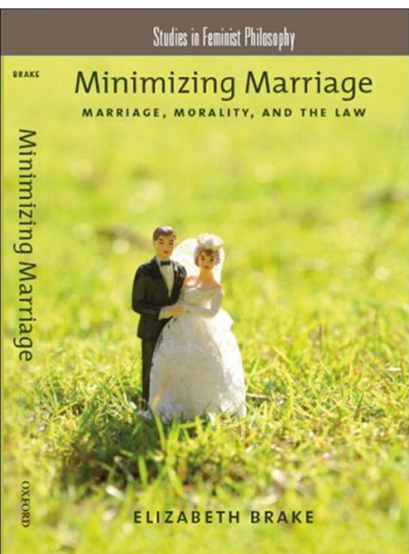
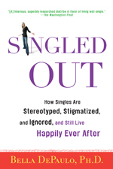
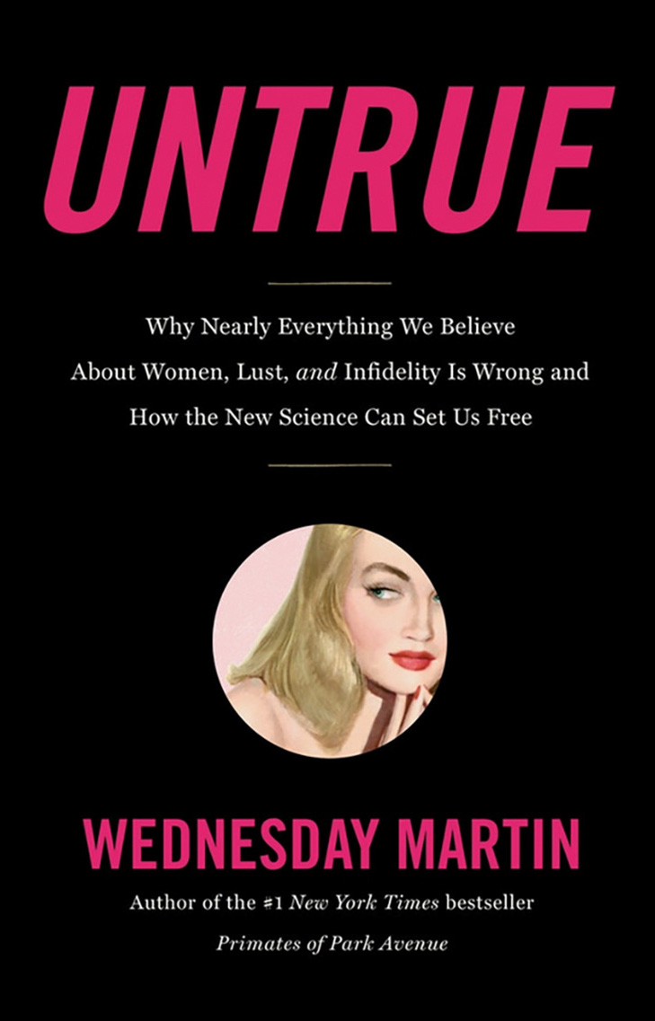
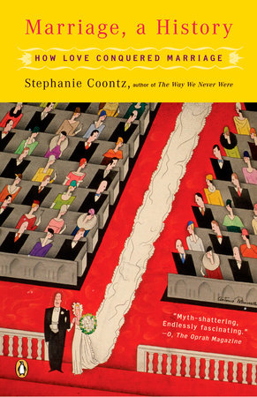
Starter Pack for Adult Staff: Deconstructing Amatonormativity & Singlism
Singled Out: How Singles are Stereotyped, Stigmatized, and Ignored, and Still Live Happily Ever After by Bella DePaulo
Minimizing Marriage: Marriage, Morality, and the Law by Elizabeth Brake
Marriage, a History: How Love Conquered Marriage by Stephanie Coontz
Untrue: Why Nearly Everything We Believe About Women, Lust, and Adultery is Wrong and How the New Science Can Set Us Free by Wednesday Martin
Notes:
ID: Starter Pack for Adult Staff: Deconstructing Amatonormativity & Singlism
Minimizing Marriage: Marriage, Morality, and the Law by Elizabeth Brake
Singled Out: How Singles are Stereotyped, Stigmatized, and Ignored, and Still Live Happily Ever After by Bella DePaulo
Untrue: Why Nearly Everything We Believe About Women, Lust, and Adultery is Wrong and How the New Science Can Set Us Free by Wednesday Martin
Marriage, a History: How Love Conquered Marriage by Stephanie Coontz
Speaker notes: Minimizing Marriage by Elizabeth Brake is where the term amatonormativity was coined
Bella DePaulo does a lot of research on singlism and how single people thrive in spite of it. She has lots of articles here: https://www.psychologytoday.com/us/contributors/bella-depaulo-phd

Slide 24
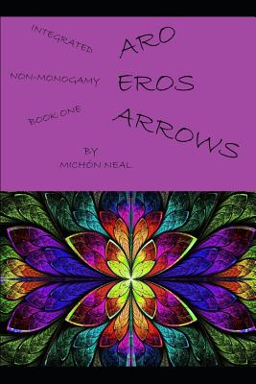
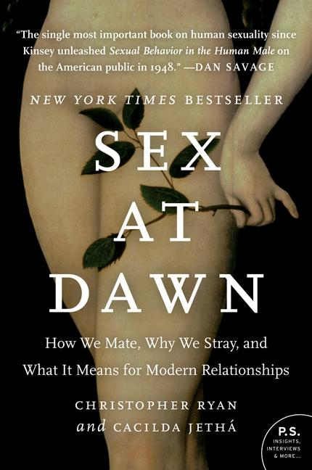
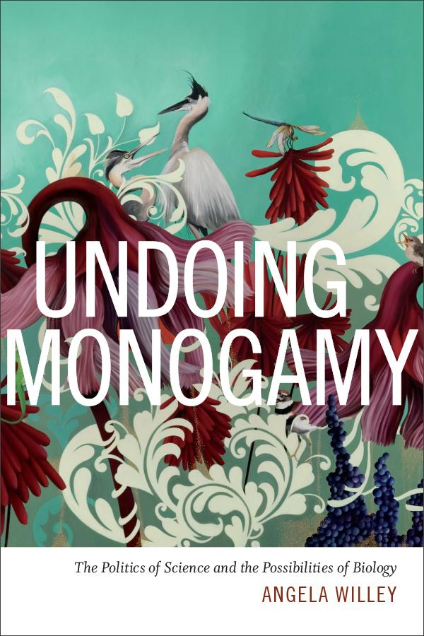
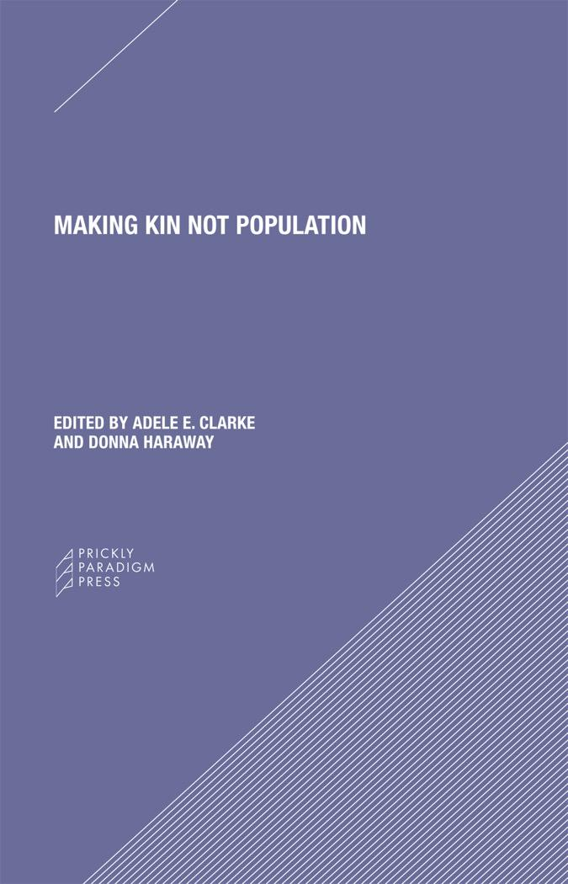
Starter Pack for Adult Staff: Deconstructing Amatonormativity & Singlism
Sex at Dawn: How We Mate, Why We Stray, and What It Means for Modern Relationships by Chris Ryan and Cacilda Jethá
Integrated Non-monogamy Book One: Aros Eros Arrows by Michón Neal
Making Kin Not Population by Kim Tallbear
Undoing Monogamy: The Politics of Science and the Possibilities of Biology by Angie Willey
Notes:
ID: Starter Pack for Adult Staff: Deconstructing Amatonormativity & Singlism
Integrated Non-monogamy Book One: Aros Eros Arrows by Michón Neal
Sex at Dawn: How We Mate, Why We Stray, and What It Means for Modern Relationships by Chris Ryan and Cacilda Jethá
Undoing Monogamy: The Politics of Science and the Possibilities of Biology by Angie Willey
Making Kin Not Population by Kim Tallbear
Speaker notes: Aros Eros Arrows by Michón Neal is the only book so far to my knowledge that focuses on aromanticism
Kim Tallbear also has a blog at http://www.criticalpolyamorist.com/ and writes a lot about deconstructing settler sexuality

Slide 25
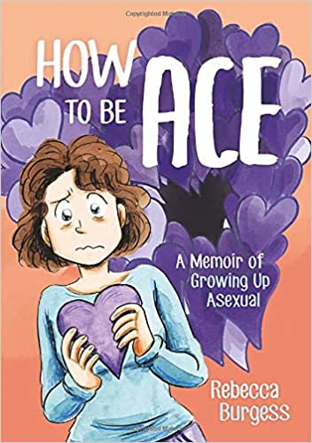
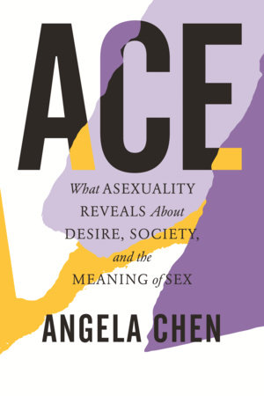
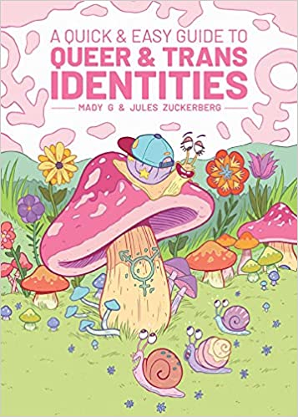
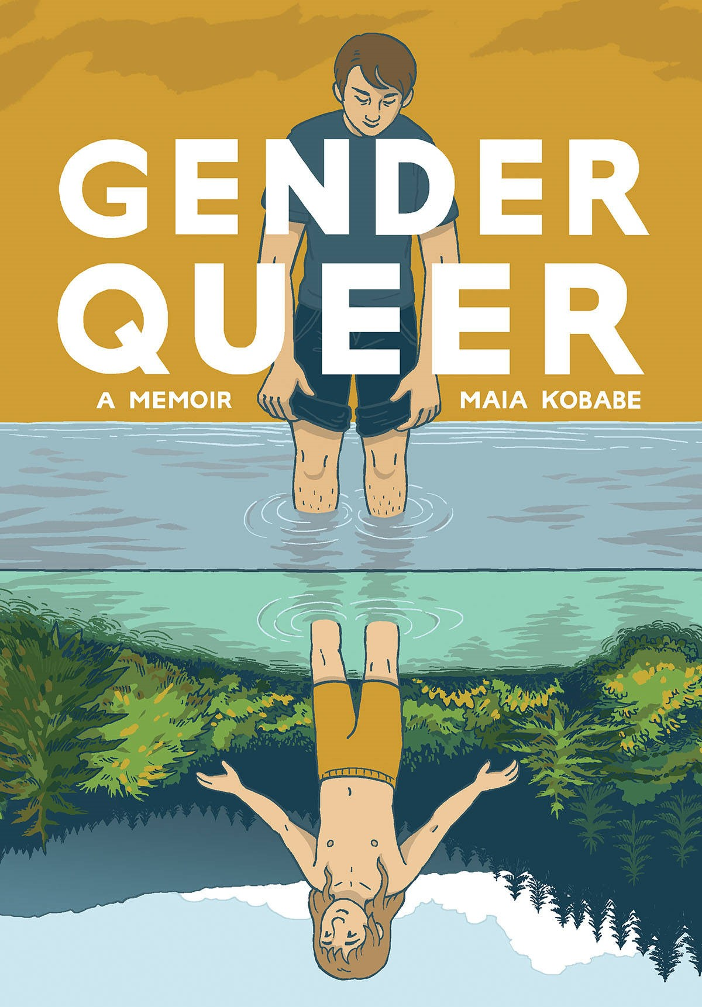
Starter Pack: Ace & Aro Books for Teens
Nonfiction
How to Be Ace: A Memoir of Growing Up Asexual by Rebecca Burgess
Ace: What Asexuality Reveals about Desire, Society, and the Meaning of Sex by Angela Chen
A Quick & Easy Guide to Queer & Trans Identities by Mady G. and Jules Zuckerberg
Gender Queer: A Memoir by Maia Kobabe
Notes:
ID: Starter Pack: Ace & Aro Books for Teens - Nonfiction
How to Be Ace: A Memoir of Growing Up Asexual by Rebecca Burgess
Ace: What Asexuality Reveals about Desire, Society, and the Meaning of Sex by Angela Chen
A Quick & Easy Guide to Queer & Trans Identities by Mady G. and Jules Zuckerberg
Gender Queer: A Memoir by Maia Kobabe

Slide 26
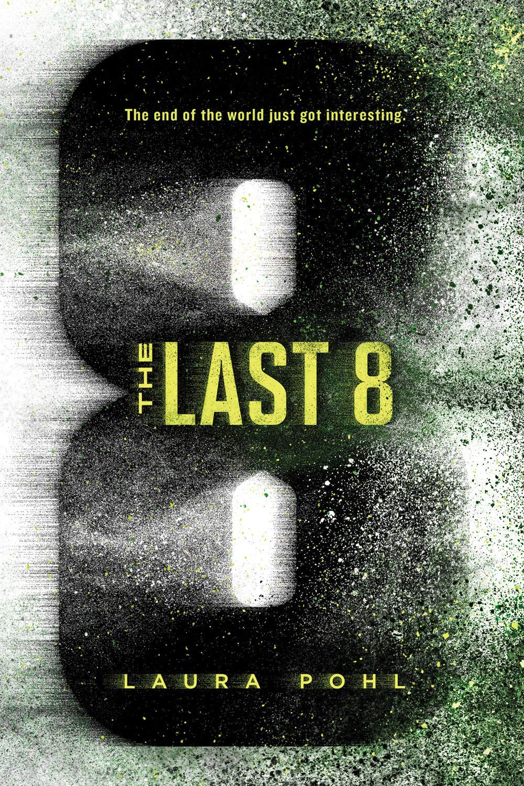
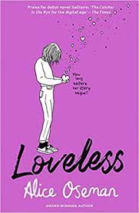
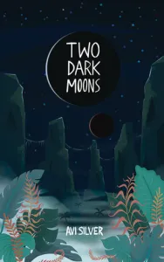
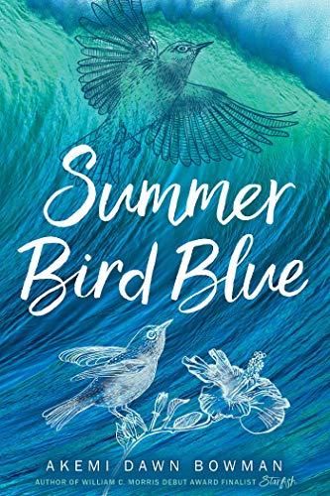
Starter Pack: Ace & Aro Books for Teens
Aro Fiction
The Last 8 by Laura Pohl
Loveless by Alice Oseman
Two Dark Moons by Avi Silver
Summer Bird Blue by Akemi Dawn Bowman
Notes:
ID: Starter Pack: Ace & Aro Books for Teens - Aro Fiction
The Last 8 by Laura Pohl
Loveless by Alice Oseman
Two Dark Moons by Avi Silver
Summer Bird Blue by Akemi Dawn Bowman

Slide 27
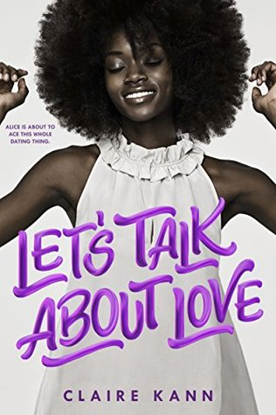
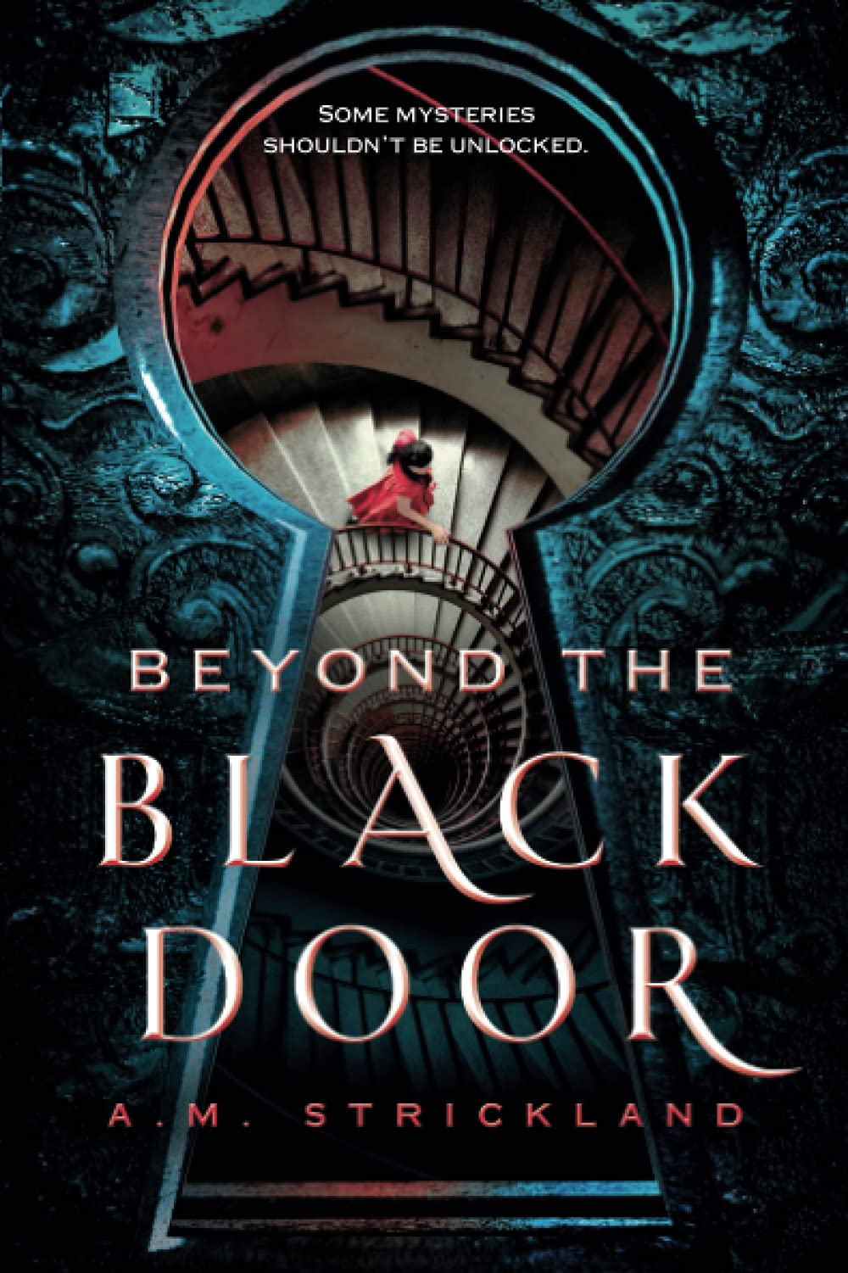
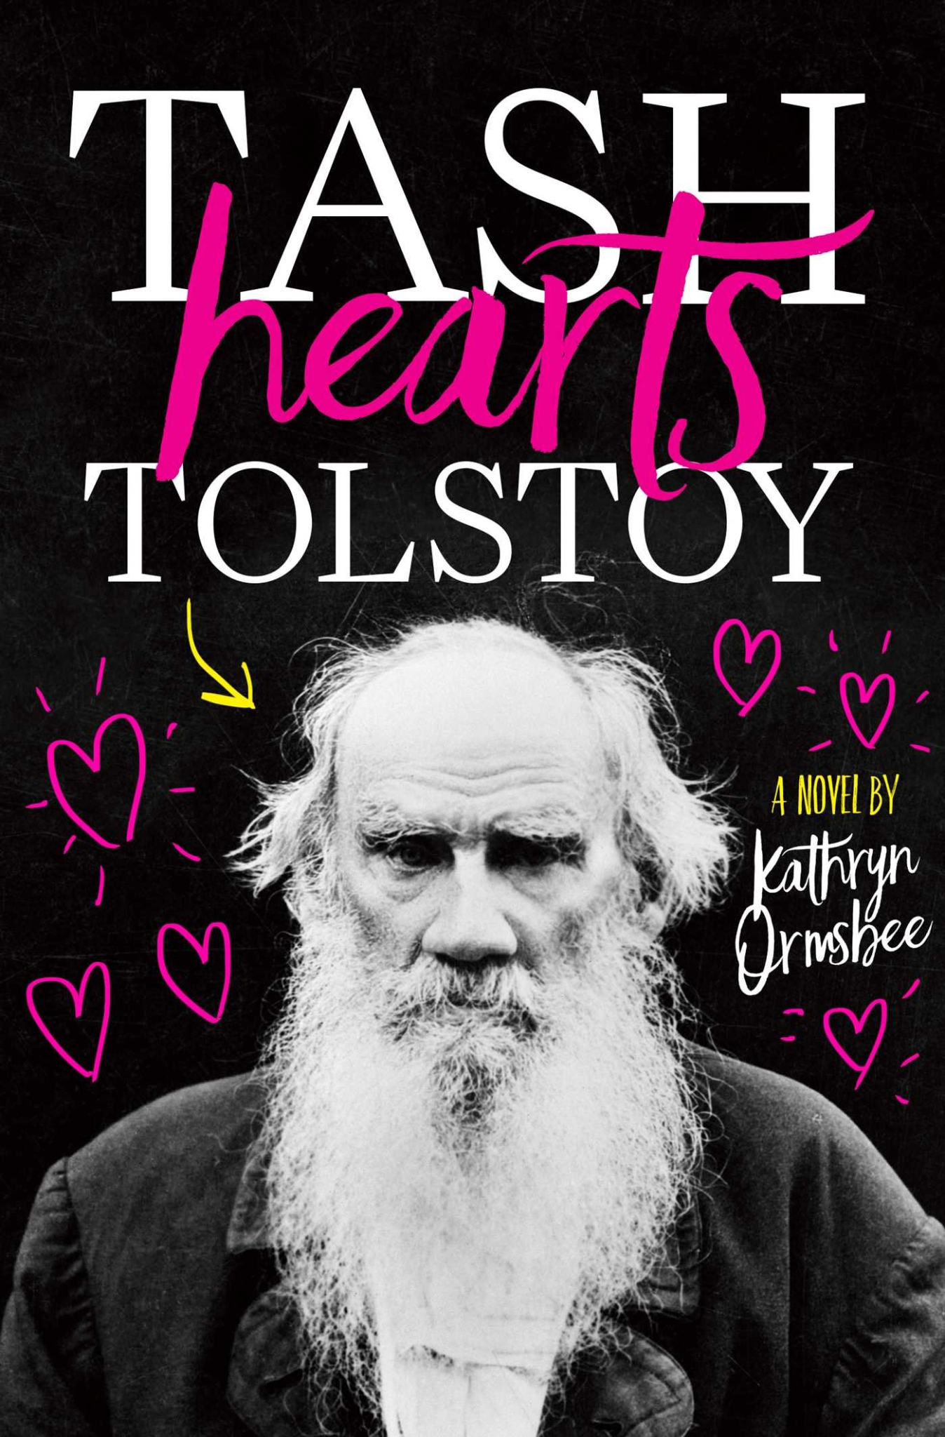
Starter Pack: Ace & Aro Books for Teens
Ace Fiction
Let’s Talk About Love by Claire Kann
Beyond the Black Door by A. M. Strickland
Every Heart A Doorway by Seanan McGuire
Tash Hearts Tolstoy by Kathryn Ormsbee
Notes:
ID: Starter Pack: Ace & Aro Books for Teens - Ace Fiction
Let’s Talk About Love by Claire Kann
Beyond the Black Door by A. M. Strickland
Every Heart A Doorway by Seanan McGuire
Tash Hearts Tolstoy by Kathryn Ormsbee

Slide 28
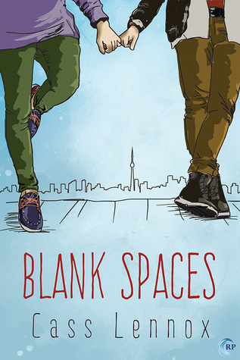
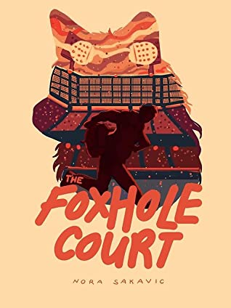
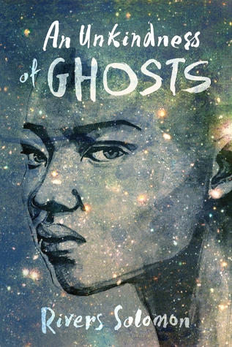
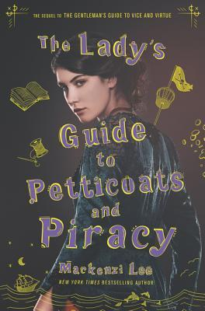
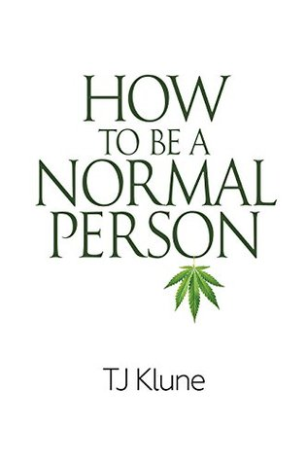
Advanced Pack: Ace & Aro Fiction Books
For Older Teens
#1-3 "Toronto Connections” series by Cass Lennox
#1-3 “All for the Game” series by Nora Sakavic
An Unkindness of Ghosts by Rivers Solomon
How to Be a Normal Person by T.J. Klune
Notes:
ID: Advanced Pack: Ace & Aro Fiction Books - For Older Teens
#1-3 "Toronto Connections” series by Cass Lennox
#1-3 “All for the Game” series by Nora Sakavic
An Unkindness of Ghosts by Rivers Solomon
How to Be a Normal Person by T.J. Klune

Slide 29
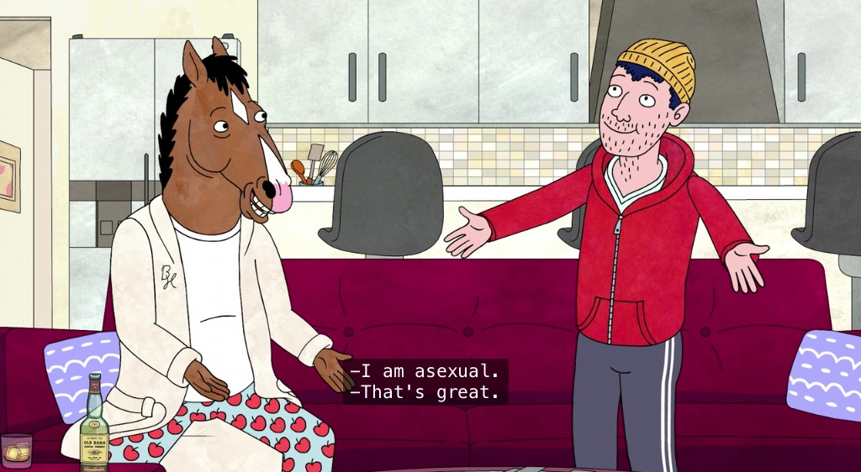
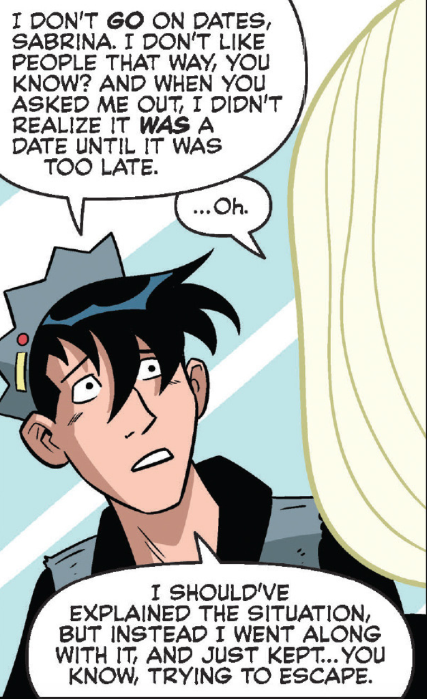
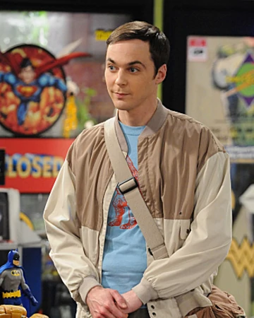
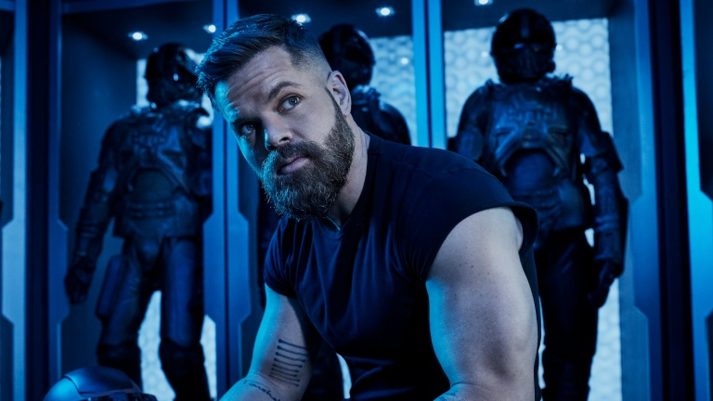
Starter Pack: Ace & Aro Representation in Popular Media
Todd Chavez
Bojack (Netflix)
Amos Burton
The Expanse
(James S.A. Corey
/Syfy)
Sheldon Cooper
The Big Bang Theory
(Warner Bros.)
Jughead Jones
Archie (DC Comics)
Notes:
ID: Starter Pack: Ace & Aro Representation in Popular Media
Todd Chavez
Bojack (Netflix)
Amos Burton
The Expanse
(James S.A. Corey/Syfy)
Jughead Jones
Archie (DC Comics)
Sheldon Cooper
The Big Bang Theory
(Warner Bros.)
Speaker notes: There's very little representation and it often gets erased, whether it's by fans who want to see romantic and sexual relationships or by other media adaptations (looking at Jughead Jones and Riverdale…). Other times, it's only confirmed by word-of-god and either retconned or censored in the media itself.

Slide 30
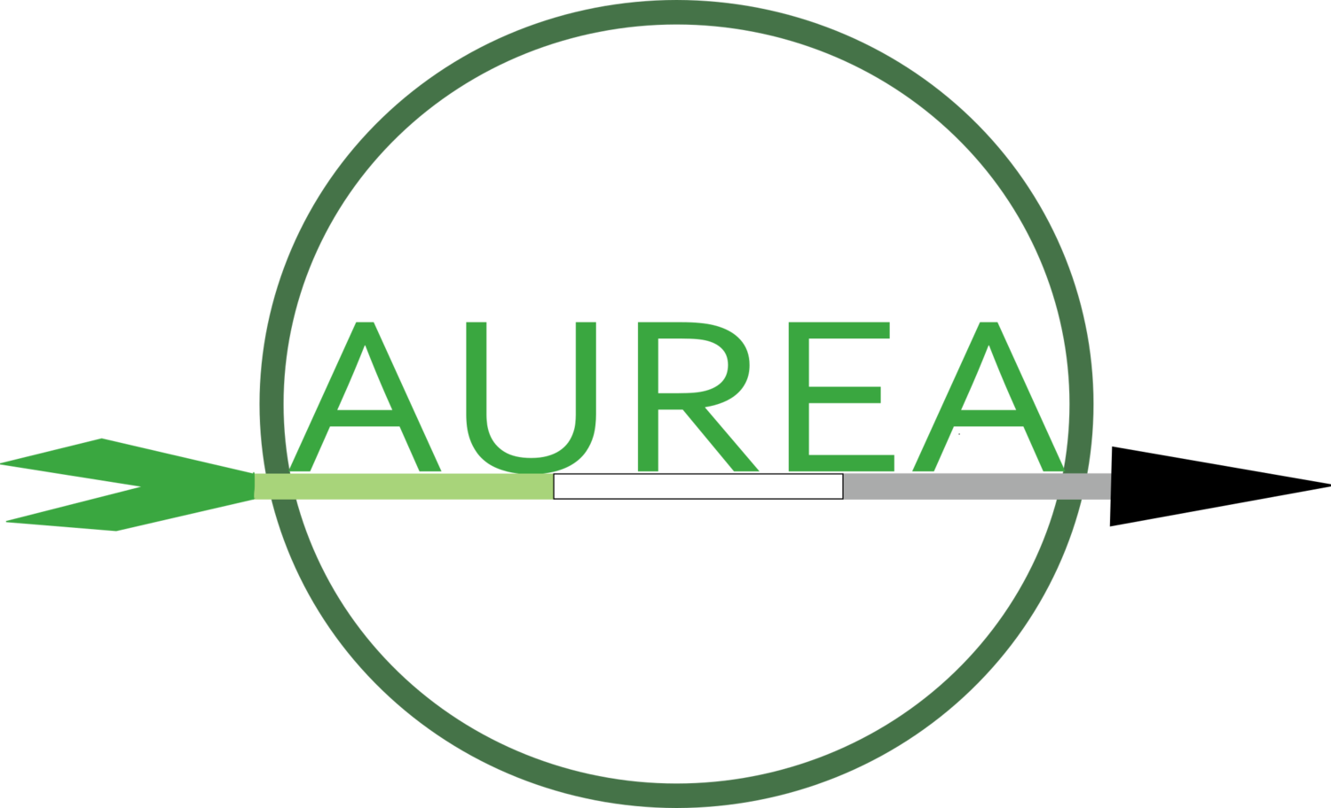
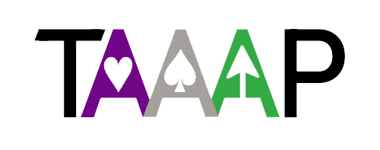
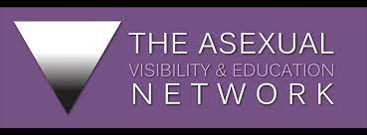
Resources
https://www.arospecweek.org
https://www.aromanticism.org/
https://taaap.org/
https://internationalasexualityday.org/en/
https://acesandaros.org
https://www.asexuality.org/
Notes:
ID: Resources
https://www.arospecweek.org
https://internationalasexualityday.org/en/
https://acesandaros.org
https://www.aromanticism.org/
https://taaap.org/
https://www.asexuality.org/

Slide 31
Contact Info and/or Q&A
Sam Helmick:
samhelmick.library@gmail.com
Elizabeth Graham:
e.a.graham01@gmail.com
Kadie Craighead: kt.craighead@ymail.com
The Ace and Aro Advocacy Project: advocacy@taaap.org
Notes:
ID: Contact Info and/or Q&A
Sam Helmick: samhelmick.library@gmail.com
Elizabeth Graham: e.a.graham01@gmail.com
Kadie Craighead: kt.craighead@ymail.com
The Ace and Aro Advocacy Project: advocacy@taaap.org
(the YALSA logo)
Speaker notes: TAAAP is also writing books! The first one is geared toward health providers, educators, and other helping professionals to help them understand aspec identities and issues and provide competent care that is sensitive to their needs. It includes anecdotal data from hundreds of aces and aros from all over the world. This one is mostly done and we are looking for a publisher. We have several more books planned.
We also have a Bookshop affiliate page where various folks in TAAAP have made book recommendations, whether they contain aspec representation or are about aspec-related issues or otherwise: https://bookshop.org/shop/taaap
And You Are Asexual, a choose your own adventure book by A. C. Evermore, was just published last month (October 2021)!

