Slide 1
WATCHING THE INVISIBLE: AROMANTICISM AND ASEXUALITY IN MEDIA
THE ACE AND ARO ADVOCACY PROJECT
MBLGTACC 2023

Slide 2
INTRODUCTION

Slide 3
ICEBREAKER
What comes to mind when you think of "groundbreaking" queer/LGBTQIA+ media representation?

Slide 4
USEFUL TERMINOLOGY
Aromantic (aro) - someone who feels little to no romantic attraction or does not connect with romance as a relationship category
Asexual (ace) - someone who feels little to no sexual attraction or feels disconnected from societal assumptions around engaging with sexuality
Aspec - someone who identifies with the aro and/or ace spectra
Amatonormativity - a term that describes the way that social norms value (committed, monogamous) romantic relationships above all other bonds and assume that everyone aspires to enter a romantic relationship and considers it central to their life
Compulsory Sexuality - the assumption that everyone desires and has socially acceptable sex (or will eventually)
Notes:
In our society, romance and sex are both seen as key life milestones, essential to human experience, and biological inevitabilities. These attitudes are described by compulsory sexuality and amatonormativity, and they contribute to stigma against aspec people and invalidation of aspec identities. They also directly support rape culture and undermine principles of consent.
Compulsory sexuality is the sociocultural assumption that everyone has or will eventually have sex and is interested in sex. This involves stigma and stereotypes against people who don’t have or haven’t had sex, such as that they are frigid or immature. People who are not interested in sex are either not believed; told they will eventually mature and develop a desire for sex; or considered sick, broken, or inhuman. Sex is often seen as a biological and/or familial responsibility - as part of couplehood, "having a family," and continuing family lines.
The term amatonormativity was coined by Elizabeth Brake and refers to the disproportionate focus on romantic relationships above all else and the widespread assumption that finding romantic love is a universally shared goal. It describes the systemic way in which these sociocultural ideas and norms are upheld - this includes the formal institution of marriage and the thousands of legal benefits it confers. Amatonormativity dictates that couplehood, and marriage in particular, is a special site of morality and a sign of maturity. People who do not marry or form nuclear family units are presumed immoral. And people who are not interested in romance are either not believed; told that they will eventually mature and develop a desire for romance; or considered heartless and inhuman, and they are vilified for any sex they may have.
These intertwine in that people are expected to form romantic-sexual coupled relationships, and sex is often held up as a special expression of romantic love, so people who do not want to have sex are often told that they cannot be a good romantic partner. People are also assumed to be open to potentially being a sexual partner, and if they are not in a relationship, they are more likely to experience sexual harassment.
Expectations of sexuality differ significantly by gender expectations and stereotypes as well. They are both heteronormative and cisnormative, intersect with stereotypes of other identities, and can have the effect of denying people agency over their romantic and/or sexual behaviour.

Slide 5
CURRENT STATE OF ASPEC REPRESENTATION
Notes:
Audience Participation: Any media springing to mind?

Slide 6
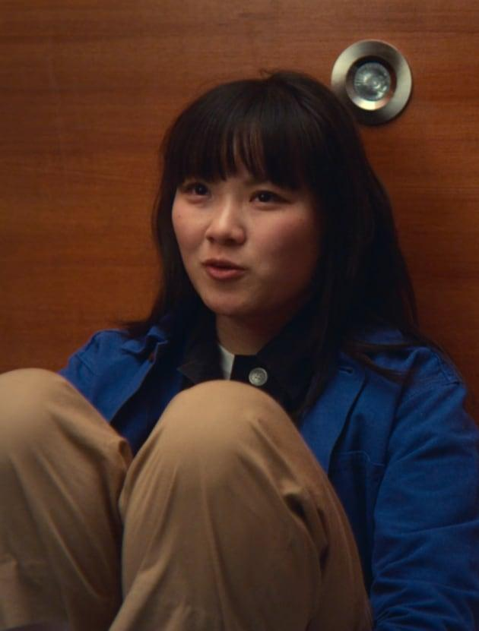
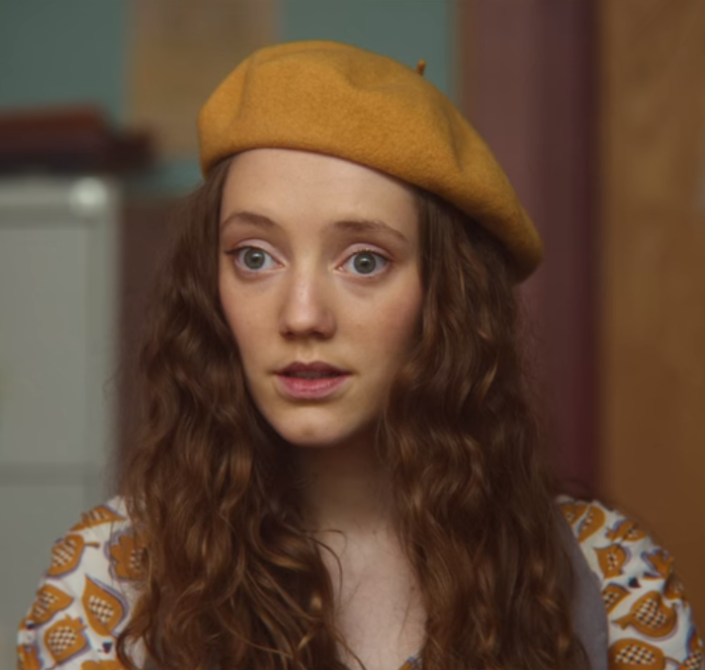
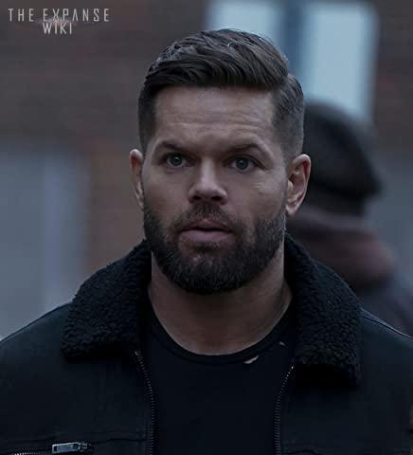
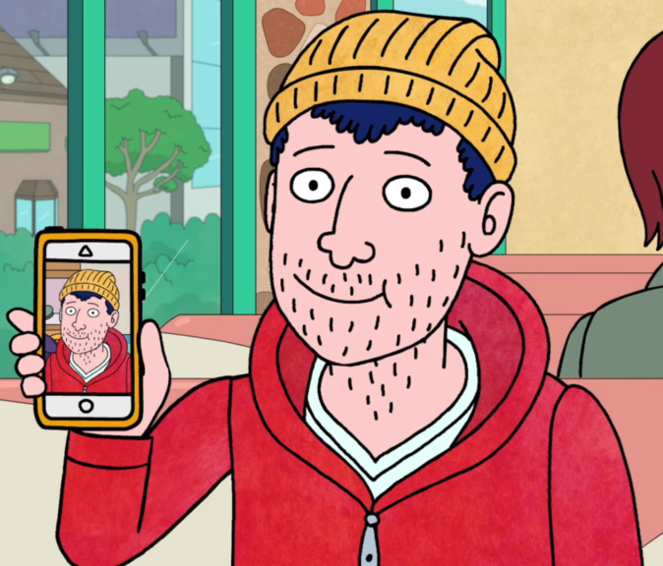
ASPEC CHARACTERS IN MEDIA (PART I)
O in Sex Education season 4 (asexual)
Florence in Sex Education season 2 (asexual)
Amos Burton in The Expanse (aromantic allosexual)
Todd Chavez in Bojack Horseman (alloromantic asexual)
Notes:
A brief list of characters who are characterized as aspec/confirmed to be so either in canon or by Word of God (creators)
Image descriptions: Photos of each character mentioned (from left to right: O, Florence, Amos, and Todd)

Slide 7
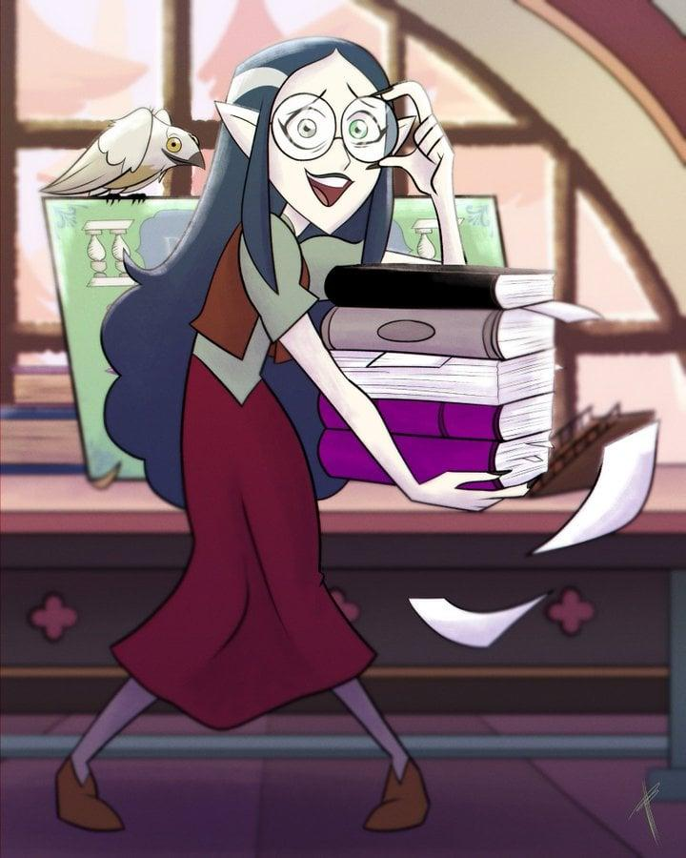
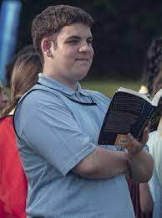
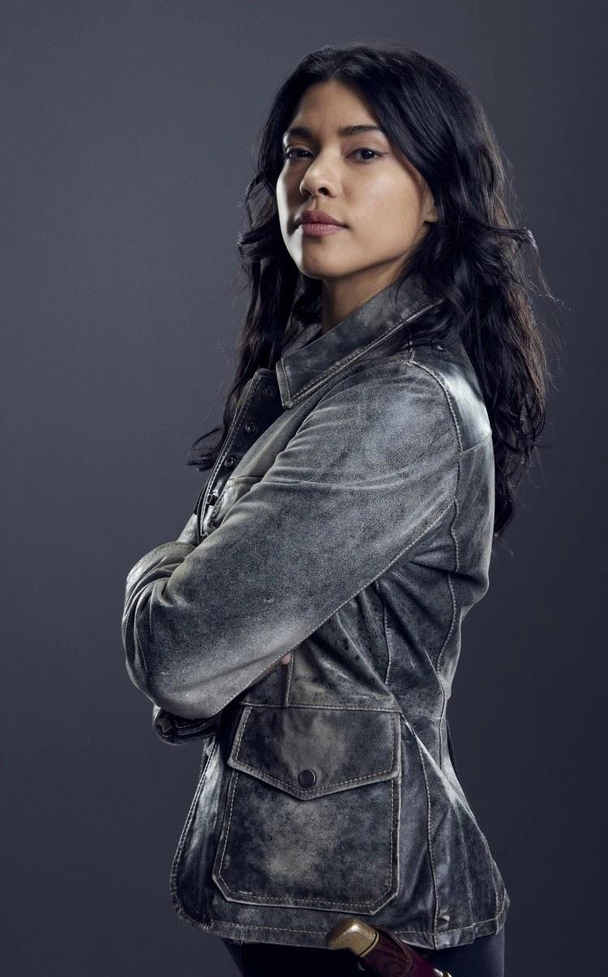
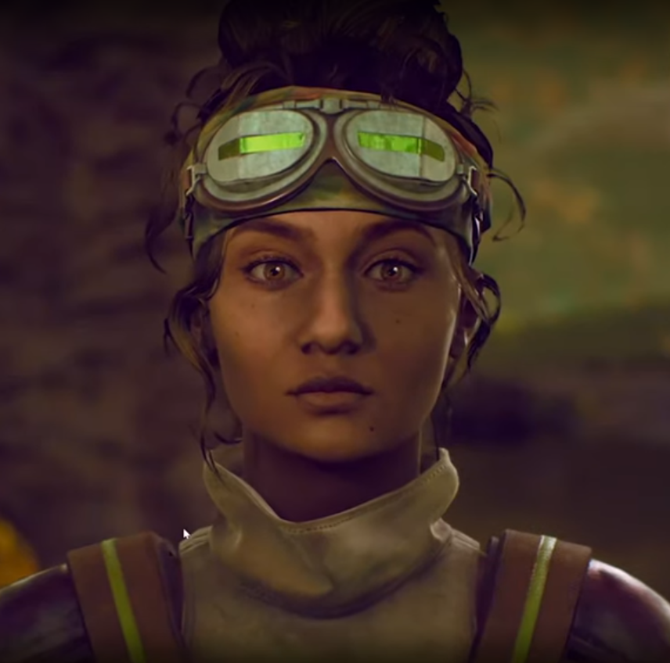
ASPEC CHARACTERS IN MEDIA (PART II)
Lilith Clawthorne in The Owl House (aromantic asexual)
Isaac Henderson in Heartstopper (aromantic asexual)
Spooner in Legends of Tomorrow (asexual)
Parvati Holcomb in The Outer Worlds (alloromantic asexual)
Notes:
Anything we notice?
Few POC, few men, all young people, mostly bookish personalities, almost all ace
Image descriptions: Photos of each character mentioned (from left to right: Lilith, Isaac, Spooner, and Parvati)

Slide 8
ASPEC-CODED CHARACTERS (NOT REPRESENTATION)
Sheldon Cooper from The Big Bang Theory
Spencer Reid from Criminal Minds
Katniss Everdeen from The Hunger Games
Merida from Brave
Elsa from Frozen
Alan Shore from Boston Legal
Dan Fielding, Roz Russell, and Selma Hacker from Night Court
Samantha Jones in Sex and the City
Eliot Spencer in Leverage
Sherlock Holmes in Sherlock, Elementary, and other adaptations
Notes:
Ben, Riley, and Fitz in Friends with Benefits
Chloe in Don’t Trust the B----- in Apartment 23
To be clear, these are not characters intentionally written as aspec or to be similar to aspecs, but they are portrayed as not having interest in romance and/or sex

Slide 9
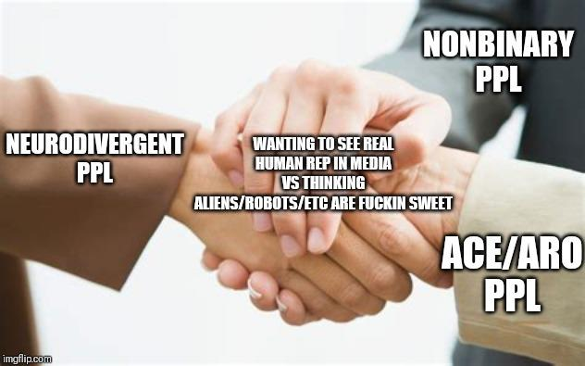
TRAITS CODED AS ASPEC
Characters who have sex without wanting romantic relationships
Characters who don’t seem to understand flirting or innuendo
This is also commonly used as a shorthand for not recognizing social cues, frequently conflated with autism-spectrum identities
Leads to people assuming that autistic = aspec
Bachelors and Spinsters
(permanently single characters)
Characters who are childlike or infantilized even as adults
Notes:
To be clear: these are traits that are NOT INTENDED by creators to be read as aspec (which we know, because creators are frequently asked and either have no idea or have been aphobic about aspec identities), but rather are frequently conflated with stereotypes and generalizations about aspec identities, many of which are very harmful.
What do we notice about how these characters are portrayed?
Characters who have sex without wanting romance get looked down on, viewed as sluts (in a derogatory way instead of celebratory) or sleazebags or morally bankrupt
Examples: Samantha Jones from Sex and the City & Dan Fielding from Night Court
Permanently single characters are depicted as forever alone, crazy cat ladies, etc.
Not understanding or not being interested in sex and/or romance is viewed as childlike or immature because of compulsory sexuality & amatonormativity – sex and romance are viewed as life milestones, so people who don't reach those milestones aren't viewed as full adults
Such characters are alternately or additionally viewed/portrayed as robotic, emotionless, etc. because they are dehumanised and neurotypical emotional expression is also conflated with humanity just like sexual & romantic feelings are
Image description: neurodivergent people, nonbinary people, and ace & aro people shaking hands over the shared experience of wanting to see real human representation in media vs. thinking aliens/robots/etc. are fuckin sweet

Slide 10
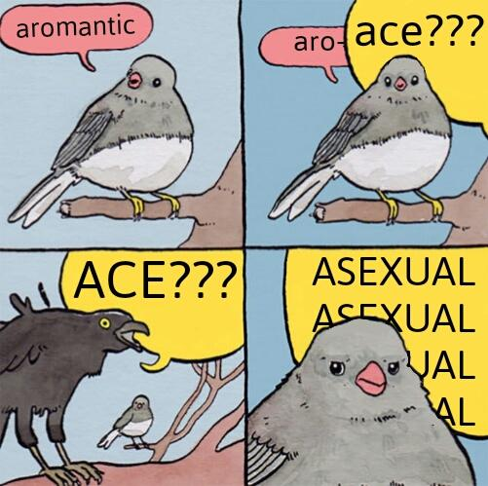
HOW APHOBIA MANIFESTS IN MEDIA
Traits associated with aro and ace identities assigned to villains
Loveless-coded characters
Characters who try to end others’ relationships
Characters who are not interested in sex or relationships not getting screentime (cough CW cough)
Sex negativity in-universe and in-fandom
Conflating aromanticism and asexuality
Notes:
Even when aspec identities are not known or named – the traits associated with our identities, or stereotypes of them, are frequently portrayed negatively
Lack of love is often used to show villainy/indicate that a character is evil
Media often revolves around sex/romance/dating
Characters who want sex without romance being demonised by both other characters as well as people consuming the media is an example of sex negativity
Image description: a bird says "aromantic" and is cut off by another bird loudly squawking "ace??? ACE??? ASEXUAL ASEXUAL ASEXUAL ASEXUAL" while the first bird looks into the figurative camera with an annoyed expression

Slide 11
EXAMPLES OF AMATONORMATIVE TROPES IN MEDIA (PART I)
All single characters get paired off into couple units
Ignoring romantic boundaries treated as acceptable, desirable behaviour
Romantic relationships treated as a reward
Casual sex "inevitably" leads to romantic feelings and a relationship
Notes:
The messaging is that people have to be coupled in order to be happy, that we are not whole or fulfilled on our own, that romantic harassment is acceptable and wholesome
Society doesn't really have a concept of romantic harassment or romantic objectification; romance-centred media frequently legitimises/normalises/encourages harmful behaviour such as persistent pursuit after rejection, stalking, controlling behaviour, becoming violent due to jealousy, etc. – this upholds rape culture
There's an entire movie of the "friendship with benefits inevitably leads to romantic feelings" trope to tell people they can't have sex without ascending the relationship escalator (the unrelated TV show Friends with Benefits is much better)

Slide 12
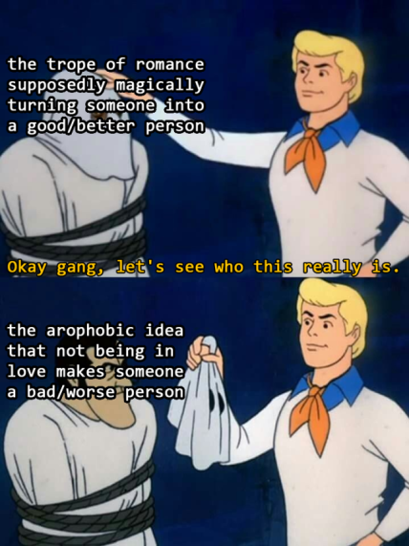
EXAMPLES OF AMATONORMATIVE TROPES IN MEDIA (PART II)
Romantic love as a redeeming quality
or storyline
Characters who do not desire romantic relationships undergo "character development" by "meeting the right person" and ending up coupled
Happy endings are equated with
romantic endings; love fixes everything
Notes:
Image description: Fred Jones from Scooby Doo says "Okay gang, let's see who this really is" as he unmasks the phantom from the episode Hassle in the Castle, labelled "the trope of romance supposedly making someone into a good/better person," to find out it is really Bluestone the Great, labelled "the arophobic idea that not being in love makes someone a bad/worse person"
These tropes are the arophobic equivalents of portraying all gay people as evil or erasing and invalidating a queer character's identity by making them conform to cisheteronormativity at the culmination of their character arc

Slide 13
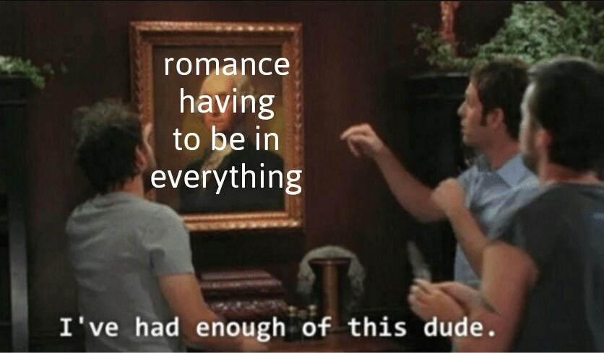
EXAMPLES OF AMATONORMATIVE TROPES IN MEDIA (PART III)
Nonmonogamy treated as an immature phase or inevitably doomed
Sex work seen as inherently demeaning, morally wrong, damaging, and unfulfilling/lesser
Romance plots shoehorned into everything
Bechdel test - character lives and
conversations frequently revolve around
romance and nothing else
Notes:
Sex work depicted this way both for workers and for clients
Media that fails the Bechdel test – i.e. women only exist as romantic interests for men and do not have conversations with each other unless they revolve around romance – is not just sexist, it's amatonormative
Does art imitate life or does life imitate art? Lots of alloromantics in real life seem to only have romance, dating, spouses, nuclear family unit, etc. as conversational topics – it's so central to their life that they assume it's central to everyone else's, too, so it's how they try to connect with other people, and sometimes it is so central to their life that they don't have many other interests
Image description: Mac from It's Always Sunny in Philadelphia looks at a portrait of George Washington, labelled "romance having to be in everything," and declares "I've had enough of this dude."

Slide 14
EXAMPLES OF COMPULSORY SEXUALITY REFLECTED IN MEDIA (PART I)
Sex, especially the first time, treated as a milestone, life-changing, coming of age event
Virginity (especially in adults) scorned, pitied, and mocked, and needing a reason like amatonormativity or religion
Romantic relationships are seen as more legitimate, or potentially only as legitimate, when sexually consummated
Notes:
Because sex is treated like a life milestone, it's associated with coming of age, so characters who don't have sex aren't really viewed as adults
People are seen as needing a reason not to have sex, like "waiting for marriage" – though this isn't necessarily respected either
Art imitates life/life imitates art again: romantic relationships being legitimised by sex is also a legal problem in real life marriage law, which can also affect things like immigration law
Also a broader problem for aspec representation – representation of characters with queer orientations is often not viewed as legitimate unless that character is actually shown having gay sex or being in a same-sex relationship. This means portrayal of characters NOT having sex or NOT being in relationships may be delegitimised as representation.

Slide 15
EXAMPLES OF COMPULSORY SEXUALITY REFLECTED IN MEDIA (PART II)
Characters suddenly becoming interested in sex when they "meet the right person"
A lack of interest in sex diagnosed as a medical issue and "fixed" with medical intervention
Masculinity as being defined in part by sexual aggressiveness and men expected to be the sexual initiator
Sex treated as reward for heroic actions or simply not being an asshole
Notes:
Characters suddenly becoming interested in sex when they "meet the right person" aren't because they are portrayed as demisexual or anything but rather because their lack of interest in sex is invalidated and they're not allowed to exist that way
Lack of interest in sex is medicalised & pathologised in real life too – the DSM did not carve out an exception for asexuality until the DSM-5 in 2013, and it's not even a very good one because it relies on people already knowing their ace identity (plus, the disorder diagnoses explicitly reinforce gendered and racial stereotypes of sexuality).
Lack of interest in romance is similarly pathologised via several personality disorder diagnoses considering it either actual diagnostic criteria or associated features supporting diagnosis. Furthermore, the entire sexual dysfunction section assumes the context of a committed romantic relationship, so anyone nonpartnering seeking help for sexual health issues is out of luck because sex therapy gets conflated with couple's therapy.
Compulsory sexuality interacts with toxic masculinity and gendered stereotypes to mean that men aren't viewed as "real men"/manly if they don't make sexual advances; inversely, sexual aggression is used to depict a character as manly – this upholds rape culture
Sex and romance being treated as rewards also feeds into rape culture & entitlement

Slide 16
WHAT REPRESENTATION DO WE WANT?
Notes:
Audience Participation: Any media springing to mind?

Slide 17
EXPLICIT REPRESENTATION
Why is it important to say "aromantic" or "asexual"? Why is "Word of God" not good enough?
Are there examples of characters whose lack of explicit identification still works?
How do we handle inter/intra-community conflict over claiming characters?
ie: Elsa!
Notes:
WE WANT PEOPLE TO LEARN ABOUT ASPEC IDENTITIES FROM REPRESENTATION!!!
Also, we want representation to be clear & visible, not just a retcon or "fun fact" for alloromantic & allosexual creators to give themselves a pat on the back – especially when sex and romance are so often used to depict/legitimise representation of other orientations
Recognise that one headcanon doesn't negate the other, people can be multiple identities at the same time, and it's okay to headcanon different kinds of identities, don't try to insist one is the only legitimate interpretation

Slide 18
INTERSECTIONALITY
What other identities do most current aspec characters share? What are we missing?
Race
Age
(Dis)ability
Gender identity
Notes:
Some more examples brought up by the audience at MBLGTACC:
ASPEC MAIN CHARACTERS
Neurotypical aspec characters, because autistic characters are so frequently desexualised & deromanticised that they are interpreted as aspec automatically
Disabled characters who are aspec because they are aspec and not because of their disability – because disabled characters also get desexualised & deromanticised by default
Kink, aces and nonsexual kink, sex work
Older aspecs as mentors
Aspecs just living their lives the way other characters are allowed to in any media
Romance repulsed characters
Sex repulsed characters
Romance favourable aros
Sex favourable aces
Characters in relationships without sex, characters in mixed orientation relationships, characters in queerplatonic relationships, polyamory

Slide 19
AND BEYOND!
Diversity of orientations
People along the aro and ace spectra (gray, demi, quoi, etc)
Allosexual aromantics!
Accessible aspec representation - in media that is not focused on sex and romance
Storylines beyond coming out
"Aspec friendly" genres beyond children’s media and horror
Aro and ace characters without angst - who are joyful in their identities!
Sex positivity
Notes:
Aspec representation located in media focused on sex and/or romance isn't always accessible to aspec audiences – for example, romance repulsed aros might not want to watch Heartstopper even if it's got aro representation, and sex repulsed aces might not want to watch Sex Education even if it's got ace representation
Being able to consume media without heavy romance and/or sex plots/content shouldn't be genre-dependent

Slide 20
HOW DO WE GET THERE?
Notes:
Improving representation, bolstering aspec creators (including fan content creators!), building community, education
Navigating disappointing characters and arcs – expressing disappointment/anger/complaints, creating fan content, disengaging

Slide 21
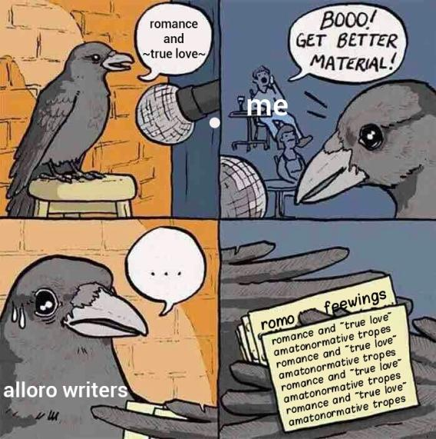
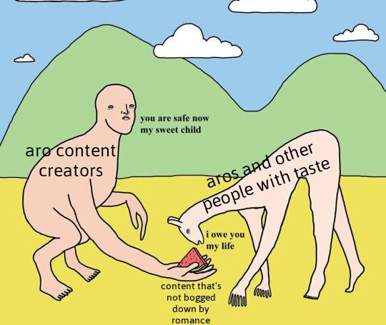
SUGGESTIONS
Notes:
Many aro content creators who create media without romance plots worry about whether alloromantics will still be interested in/connect to their work. When will alloromantic & allosexual content creators start showing this consideration for aspec audiences?
Left image description: a bird up on stage in the spotlight says "romance and ~true love~" into the microphone. The audience, labelled "me," shouts "BOOO! GET BETTER MATERIAL!" The bird, labelled "alloro writers," sweats and hesitates, flipping through its notecards to find that they all say "romance and ~true love~," "amatonormative tropes," and "romo feewings" repeatedly.
Right image description: "Aro content creators" stoop down with "content that's not bogged down by romance" in their hand, saying "You are safe now my sweet child" as they feed "aros and other people with taste," who reply "I owe you my life."

Slide 22
MORE RESOURCES
The Ace and Aro Characters Database: https://www.aroacedatabase.com/
TAAAP Bookshop.org: https://bookshop.org/shop/taaap
Notes:
The aro ace database focuses on aspec representation in fiction books. It was started by Claudie Arsenault, who has written much of that representation herself, and has blossomed into a large community-built resource. Characters/works can be searched by which specific aspec orientations are represented, and there is typically other information like how much sexual or romantic content is in the book.
Bookshop.org is a website that connects people to small retailers instead of Scamazon, so purchases made through our affiliate Bookshop link support both independent bookstores and TAAAP (we receive a commission). We have lists of aspec fiction, aspec nonfiction, resources to learn more about amatonormativity and compulsory sexuality, and so on.

